Slide 2
Introduction: Let us remember the big picture of what is happening before we dig into Revelation, chapter 7.
John is in the throne room of heaven. The Exalted Christ begins to break the seven seals of the Scroll of Destiny one by one. As He does, the worst days of planet earth begin.

Slide 3
Introduction: Let us remember the big picture of what is happening before we dig into Revelation, chapter 7.
John is in the throne room of heaven. The Exalted Christ begins to break the seven seals of the Scroll of Destiny one by one. As He does, the worst days of planet earth begin.

Slide 4
Introduction: Let us remember the big picture of what is happening before we dig into Revelation, chapter 7.
John is in the throne room of heaven. The Exalted Christ begins to break the seven seals of the Scroll of Destiny one by one. As He does, the worst days of planet earth begin.

Slide 5
Introduction: Let us remember the big picture of what is happening before we dig into Revelation, chapter 7.
John is in the throne room of heaven. The Exalted Christ begins to break the seven seals of the Scroll of Destiny one by one. As He does, the worst days of planet earth begin.

Slide 6
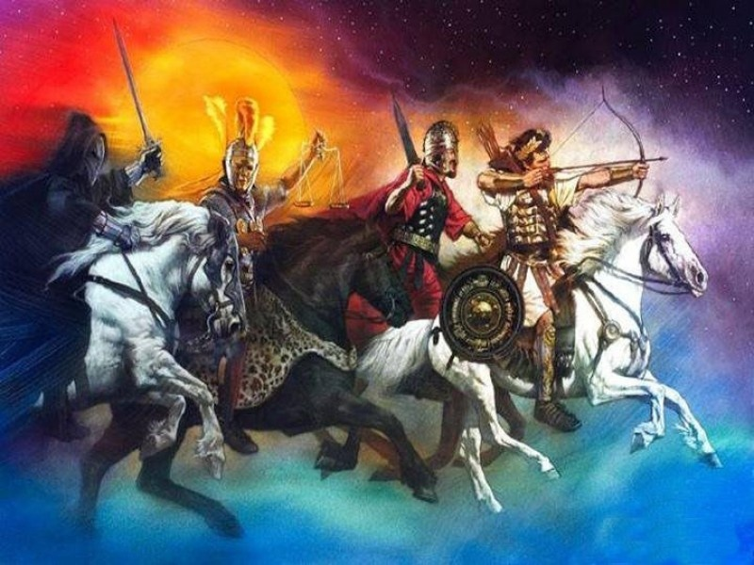
A series of judgments fall upon the earth. The first four are signaled by the appearance of four horsemen.

Slide 7
A series of judgments fall upon the earth. The first four are signaled by the appearance of four horsemen.

Slide 8
A series of judgments fall upon the earth. The first four are signaled by the appearance of four horsemen.

Slide 9
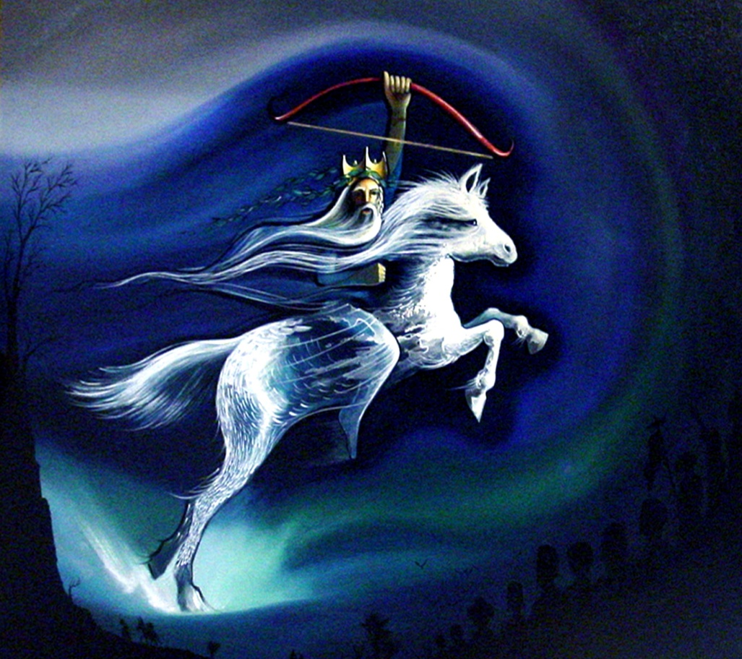
The rise of the Antichrist to power begins the seven year tribulation.

Slide 10
The rise of the Antichrist to power begins the seven year tribulation.

Slide 11
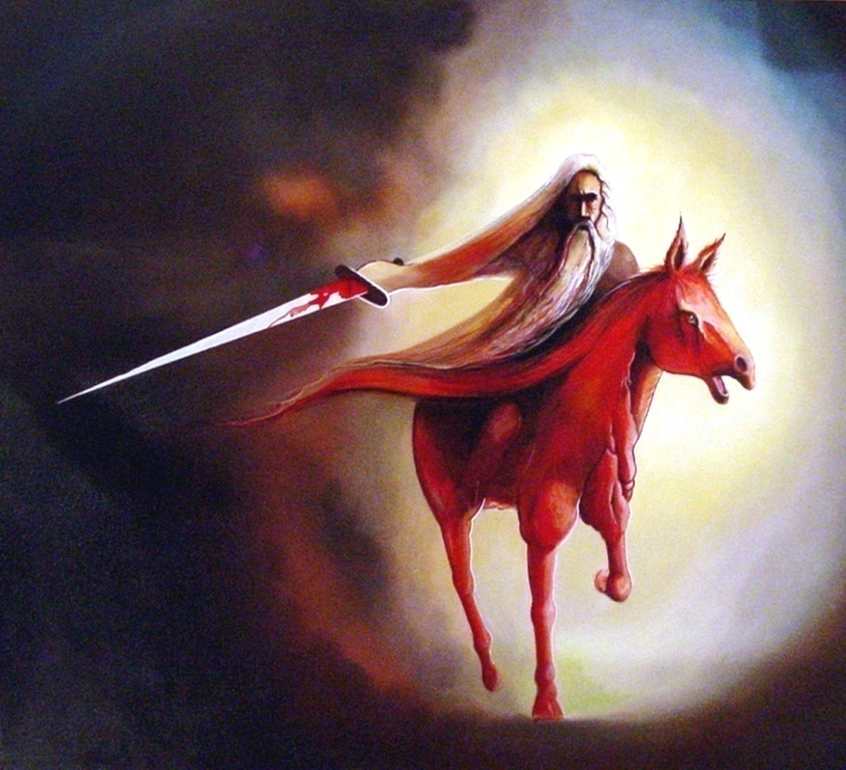
The Second Horseman – War (probably the war of Gog and Magog of Ezekiel 38 & 39)

Slide 12
The Second Horseman – War (probably the war of Gog and Magog of Ezekiel 38 & 39)

Slide 13
The Jews will turn away from their predominate atheism and begin again to worship God.
Many Gentile nations will recognize that God delivered Israel, opening the door of receptivity to the gospel.

Slide 14
The Jews will turn away from their predominate atheism and begin again to worship God.
Many Gentile nations will recognize that God delivered Israel, opening the door of receptivity to the gospel.

Slide 15
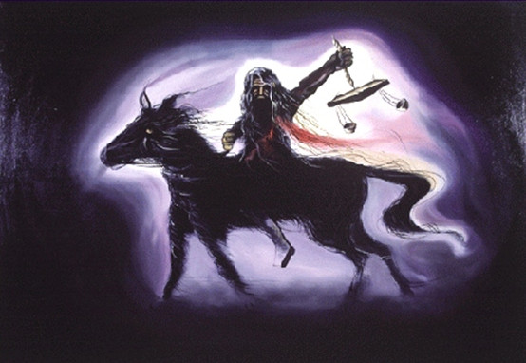
The Third Horseman – Scarcity, Inflation, and Famine

Slide 16
The Third Horseman – Scarcity, Inflation, and Famine

Slide 17
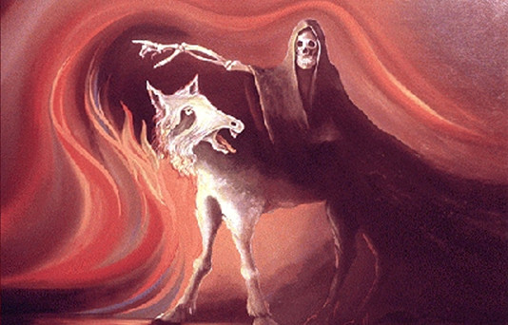
The Fourth Horseman – Death to ¼ of the earth

Slide 18
The Fourth Horseman – Death to ¼ of the earth

Slide 19
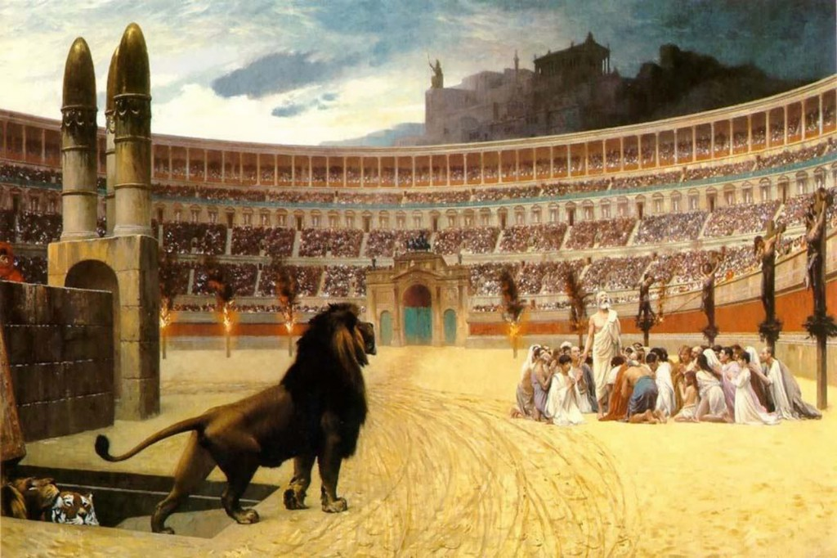
The Fifth Seal – Martyrdom

Slide 20
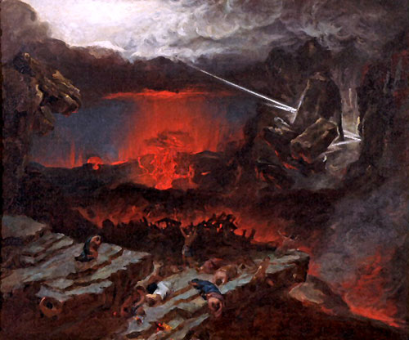
The Sixth Seal – Cosmic Disturbances

Slide 21
The Sixth Seal – Cosmic Disturbances

Slide 22
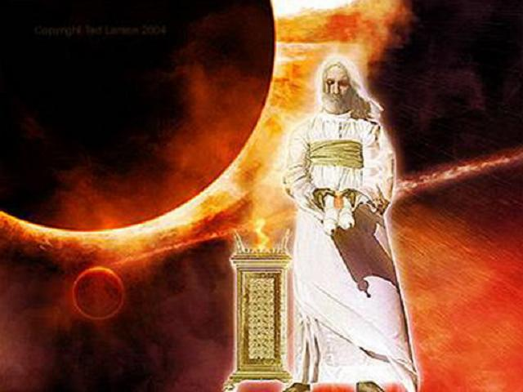
What many fail to see in a casual reading of Revelation is really the most important truth: THE WORST DAYS HAVE BEGUN TO USHER IN THE BEST DAYS.

Slide 23
What many fail to see in a casual reading of Revelation is really the most important truth: THE WORST DAYS HAVE BEGUN TO USHER IN THE BEST DAYS.

Slide 24
Revelation 7:1–8 1 After these things I saw four angels standing at the four corners of the earth, holding the four winds of the earth, that the wind should not blow on the earth, on the sea, or on any tree. 2 Then I saw another angel ascending from the east, having the seal of the living God. And he cried with a loud voice to the four angels to whom it was granted to harm the earth and the sea,

Slide 25
3 saying, “Do not harm the earth, the sea, or the trees till we have sealed the servants of our God on their foreheads.” 4 And I heard the number of those who were sealed. One hundred and forty-four thousand of all the tribes of the children of Israel were sealed:

Slide 26
5 of the tribe of Judah twelve thousand were sealed;
of the tribe of Reuben twelve thousand were sealed;
of the tribe of Gad twelve thousand were sealed;
6 of the tribe of Asher twelve thousand were sealed;
of the tribe of Naphtali twelve thousand were sealed;
of the tribe of Manasseh twelve thousand were sealed;

Slide 27
7 of the tribe of Simeon twelve thousand were sealed;
of the tribe of Levi twelve thousand were sealed;
of the tribe of Issachar twelve thousand were sealed;
8 of the tribe of Zebulun twelve thousand were sealed;
of the tribe of Joseph twelve thousand were sealed;
of the tribe of Benjamin twelve thousand were sealed.

Slide 28
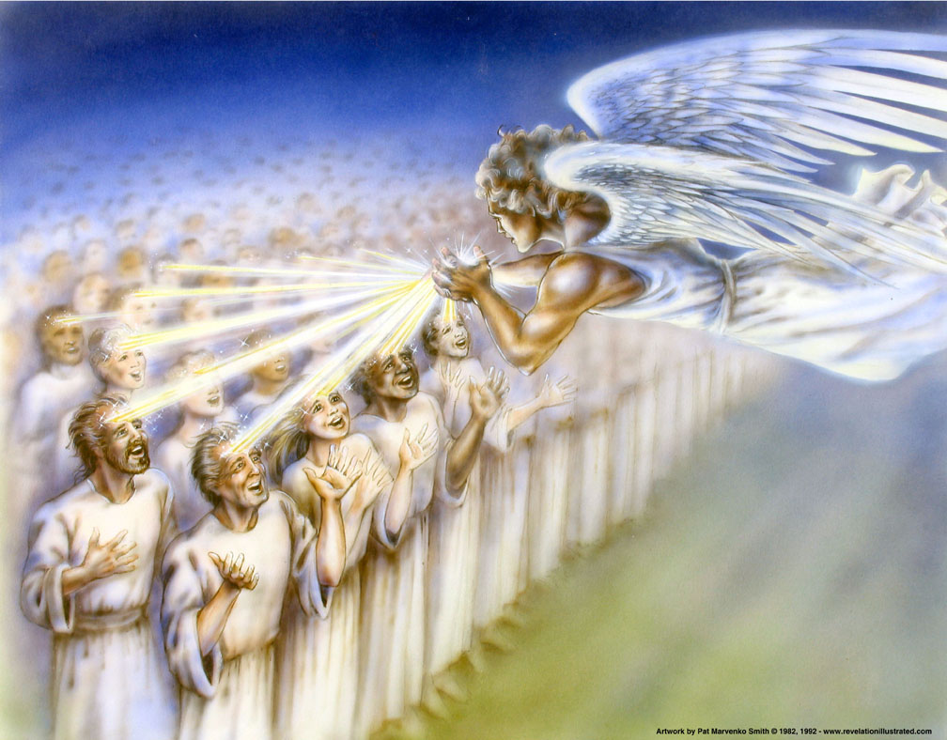
GOD SEALS 144,000.
I do not mean to be unkind, but I do mean to be clear. These are not Jehovah´s Witnesses.

Slide 29
GOD SEALS 144,000.
I do not mean to be unkind, but I do mean to be clear. These are not Jehovah´s Witnesses.

Slide 30
Who are the 144,000? These are all Jews – 12,000 from each tribe.
Right now, there are nearly 6 million Jews residing in Israel, more than 13 million around the globe. The 144,000 Jews constitute slightly more than 1% of the Jews in the world.

Slide 31
Who are the 144,000? These are all Jews – 12,000 from each tribe.
Right now, there are nearly 6 million Jews residing in Israel, more than 13 million around the globe. The 144,000 Jews constitute slightly more than 1% of the Jews in the world.

Slide 32
Who are the 144,000? These are all Jews – 12,000 from each tribe.
Right now, there are nearly 6 million Jews residing in Israel, more than 13 million around the globe. The 144,000 Jews constitute slightly more than 1% of the Jews in the world.

Slide 33
Who are the 144,000? These are all Jews – 12,000 from each tribe.
Right now, there are nearly 6 million Jews residing in Israel, more than 13 million around the globe. The 144,000 Jews constitute slightly more than 1% of the Jews in the world.

Slide 34
What does God do for and to the 144,000? God protects these Jews in two ways:
Rev. 7:3 tells us that God does not allow the second seal judgment and those that follow it to begin until His seal of protection is put upon them.
He puts His seal on their foreheads.

Slide 35
What does God do for and to the 144,000? God protects these Jews in two ways:
Rev. 7:3 tells us that God does not allow the second seal judgment and those that follow it to begin until His seal of protection is put upon them.
He puts His seal on their foreheads.

Slide 36
What does God do for and to the 144,000? God protects these Jews in two ways:
Rev. 7:3 tells us that God does not allow the second seal judgment and those that follow it to begin until His seal of protection is put upon them.
He puts His seal on their foreheads.

Slide 37
God´s seal protects them from future harm. We know this from passages like Rev. 9:4 which tells of frightening demonic creatures that are loosed upon the earth, but they cannot hurt those with the seal of God on their forehead.

Slide 38
God´s seal protects them from future harm. We know this from passages like Rev. 9:4 which tells of frightening demonic creatures that are loosed upon the earth, but they cannot hurt those with the seal of God on their forehead.

Slide 39
We do not know if the seal of God was visible to human eyes, but it was certainly visible to angels and demons alike who knew it was there.
Besides protection, what else does the seal mean?

Slide 40
We do not know if the seal of God was visible to human eyes, but it was certainly visible to angels and demons alike who knew it was there.
Besides protection, what else does the seal mean?

Slide 41
2 Corinthians 1:21–22 21 Now He who establishes us with you in Christ and has anointed us is God, 22 who also has sealed us and given us the Spirit in our hearts as a guarantee.
It means Salvation! God saves and seals these 144,000 Jews. What is the primary task God gives to saved people?

Slide 42
2 Corinthians 1:21–22 21 Now He who establishes us with you in Christ and has anointed us is God, 22 who also has sealed us and given us the Spirit in our hearts as a guarantee.
It means Salvation! God saves and seals these 144,000 Jews. What is the primary task God gives to saved people?

Slide 43
Matthew 28:19–20 19 Go therefore and make disciples of all the nations, baptizing them in the name of the Father and of the Son and of the Holy Spirit, 20 teaching them to observe all things that I have commanded you; and lo, I am with you always, even to the end of the age.”

Slide 44
Acts 1:8 But you shall receive power when the Holy Spirit has come upon you; and you shall be witnesses to Me in Jerusalem, and in all Judea and Samaria, and to the end of the earth.”

Slide 45
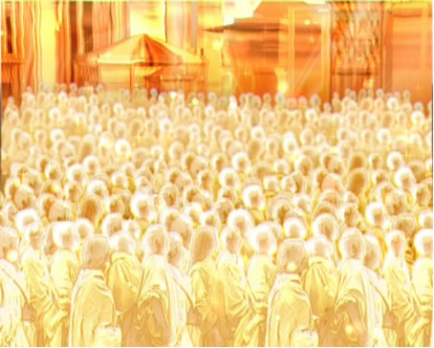
Through the ministry of the 144,000 saved Jewish men, and through the powerful working of the Holy Spirit,
GOD BRINGS ABOUT THE GREATEST OF THE GREAT AWAKENINGS.

Slide 46
Through the ministry of the 144,000 saved Jewish men, and through the powerful working of the Holy Spirit,
GOD BRINGS ABOUT THE GREATEST OF THE GREAT AWAKENINGS.

Slide 47
Revelation 7:9–17 9 After these things I looked, and behold, a great multitude which no one could number, of all nations, tribes, peoples, and tongues, standing before the throne and before the Lamb, clothed with white robes, with palm branches in their hands, 10 and crying out with a loud voice, saying, “Salvation belongs to our God who sits on the throne, and to the Lamb!”

Slide 48
11 All the angels stood around the throne and the elders and the four living creatures, and fell on their faces before the throne and worshiped God, 12 saying: “Amen! Blessing and glory and wisdom, Thanksgiving and honor and power and might, Be to our God forever and ever. Amen.”

Slide 49
13 Then one of the elders answered, saying to me, “Who are these arrayed in white robes, and where did they come from?” 14 And I said to him, “Sir, you know.” So he said to me, “These are the ones who come out of the great tribulation, and washed their robes and made them white in the blood of the Lamb.

Slide 50
15 Therefore they are before the throne of God, and serve Him day and night in His temple. And He who sits on the throne will dwell among them. 16 They shall neither hunger anymore nor thirst anymore; the sun shall not strike them, nor any heat; 17 for the Lamb who is in the midst of the throne will shepherd them and lead them to living fountains of waters. And God will wipe away every tear from their eyes.”

Slide 51
A great multitude which no one could number | Too many to count!

Slide 52
Of every nation, tribe, people, and tongue | Matthew 24:14 And this gospel of the kingdom will be preached in all the world as a witness to all the nations, and then the end will come.

Slide 53
Standing before the throne | When the sixth seal judgment falls and the great earthquake causes the people of the earth to hide in caves, they called out, “Who can stand?” Here is the answer: those who have trusted the Lord Jesus Christ are able to stand.

Slide 54
Standing before the throne | When the sixth seal judgment falls and the great earthquake causes the people of the earth to hide in caves, they called out, “Who can stand?” Here is the answer: those who have trusted the Lord Jesus Christ are able to stand.

Slide 55
Clothed with white robes | Symbols of their righteousness

Slide 56
Clothed with white robes | Symbols of their righteousness

Slide 57
With palm branches in their hands | The children of Israel were told on the first day of the Feast of Tabernacles to celebrate with palm branches. They were celebrating God´s provision for His people during the wilderness wanderings, but they were also anticipating the time that they would live in the presence of God.

Slide 58
With palm branches in their hands | The children of Israel were told on the first day of the Feast of Tabernacles to celebrate with palm branches. They were celebrating God´s provision for His people during the wilderness wanderings, but they were also anticipating the time that they would live in the presence of God.

Slide 59
They cried out, “Salvation belongs to our God Who sits on the throne, and to the Lamb!” | These are all saved people, people who have been saved out of every people group on the face of the earth!

Slide 60
They cried out, “Salvation belongs to our God Who sits on the throne, and to the Lamb!” | These are all saved people, people who have been saved out of every people group on the face of the earth!

Slide 61
These have come out of the great tribulation … | Why will God show His righteousness through severe judgment?

Slide 62
These have come out of the great tribulation … | Why will God save and seal 144,000 Jewish men and send them out on mission across the face of the globe?

Slide 63
These have come out of the great tribulation … | Why will God save and seal 144,000 Jewish men and send them out on mission across the face of the globe?

Slide 64
These have come out of the great tribulation … | So that even in the worst days of tribulation that have ever fallen upon planet earth, there would be a great multitude which no one could even count who would be saved and brought to live with Him for all eternity!

Slide 65
These have come out of the great tribulation … | So that even in the worst days of tribulation that have ever fallen upon planet earth, there would be a great multitude which no one could even count who would be saved and brought to live with Him for all eternity!

Slide 66
And how did they get there? They washed their robes and made them white in the blood of the Lamb. | What holy irony that when you are washed in the blood of the Lamb, your garments are made white and clean.

Slide 67
And how did they get there? They washed their robes and made them white in the blood of the Lamb. | What holy irony that when you are washed in the blood of the Lamb, your garments are made white and clean.

Slide 68
And what are the results?
God will dwell with them!
They will have no need or pain.
The Lamb of God will lead them to fountains of living water.
He Himself will be their shepherd.
And God will wipe away every tear from their eyes.

Slide 69
And what are the results?
God will dwell with them!
They will have no need or pain.
The Lamb of God will lead them to fountains of living water.
He Himself will be their shepherd.
And God will wipe away every tear from their eyes.

Slide 70
And what are the results?
God will dwell with them!
They will have no need or pain.
The Lamb of God will lead them to fountains of living water.
He Himself will be their shepherd.
And God will wipe away every tear from their eyes.

Slide 71
And what are the results?
God will dwell with them!
They will have no need or pain.
The Lamb of God will lead them to fountains of living water.
He Himself will be their shepherd.
And God will wipe away every tear from their eyes.

Slide 72
And what are the results?
God will dwell with them!
They will have no need or pain.
The Lamb of God will lead them to fountains of living water.
He Himself will be their shepherd.
And God will wipe away every tear from their eyes.

Slide 73
And what are the results?
God will dwell with them!
They will have no need or pain.
The Lamb of God will lead them to fountains of living water.
He Himself will be their shepherd.
And God will wipe away every tear from their eyes.

Slide 74
CONCLUSION: Each of us can be a part of that great multitude the same way each of them became a part – through personal faith in Jesus Christ as our Lord and Savior.

Slide 75
CONCLUSION: Each of us can be a part of that great multitude the same way each of them became a part – through personal faith in Jesus Christ as our Lord and Savior.

