Slide 2
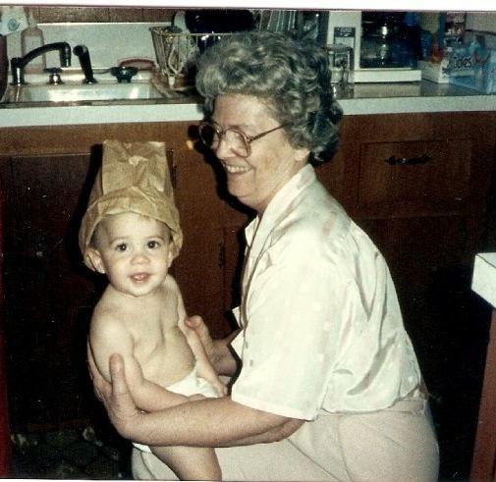

Slide 3
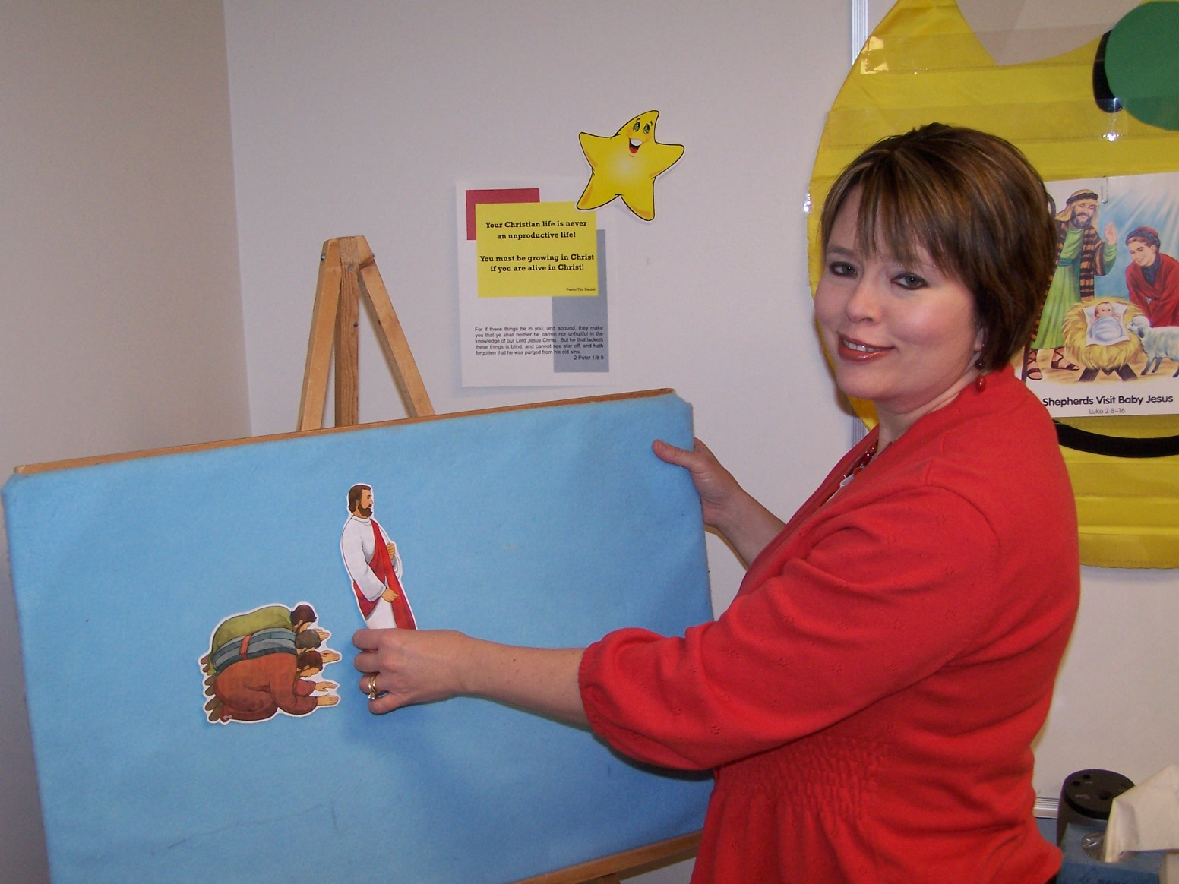

Slide 4
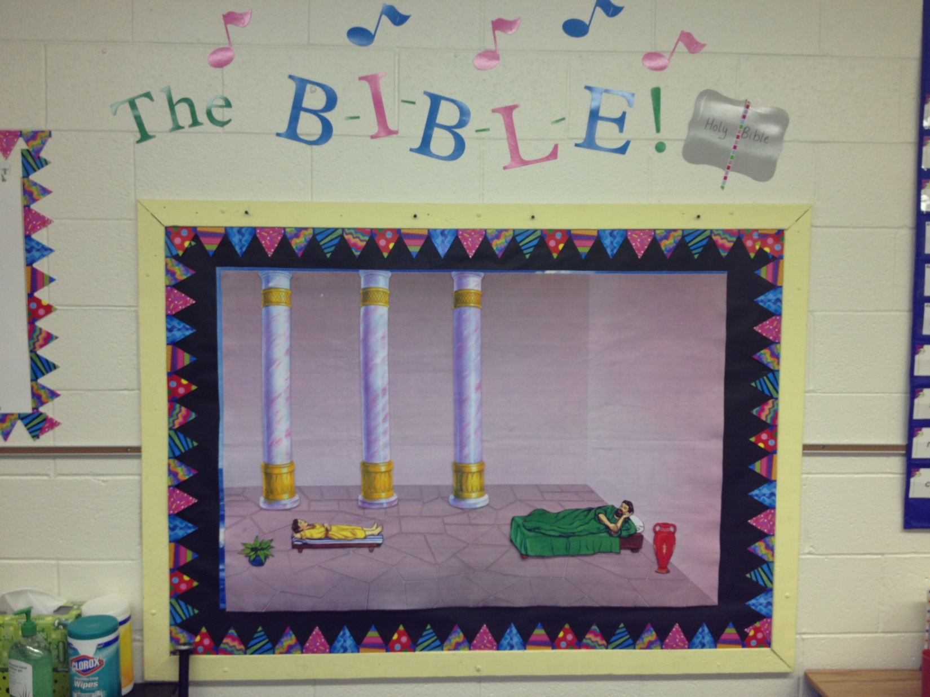

Slide 5
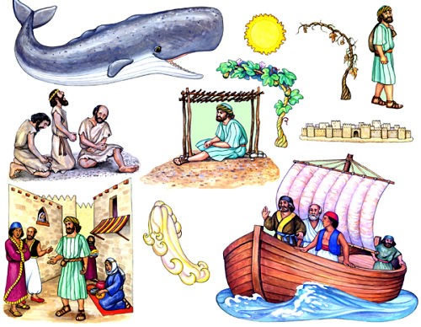

Slide 6
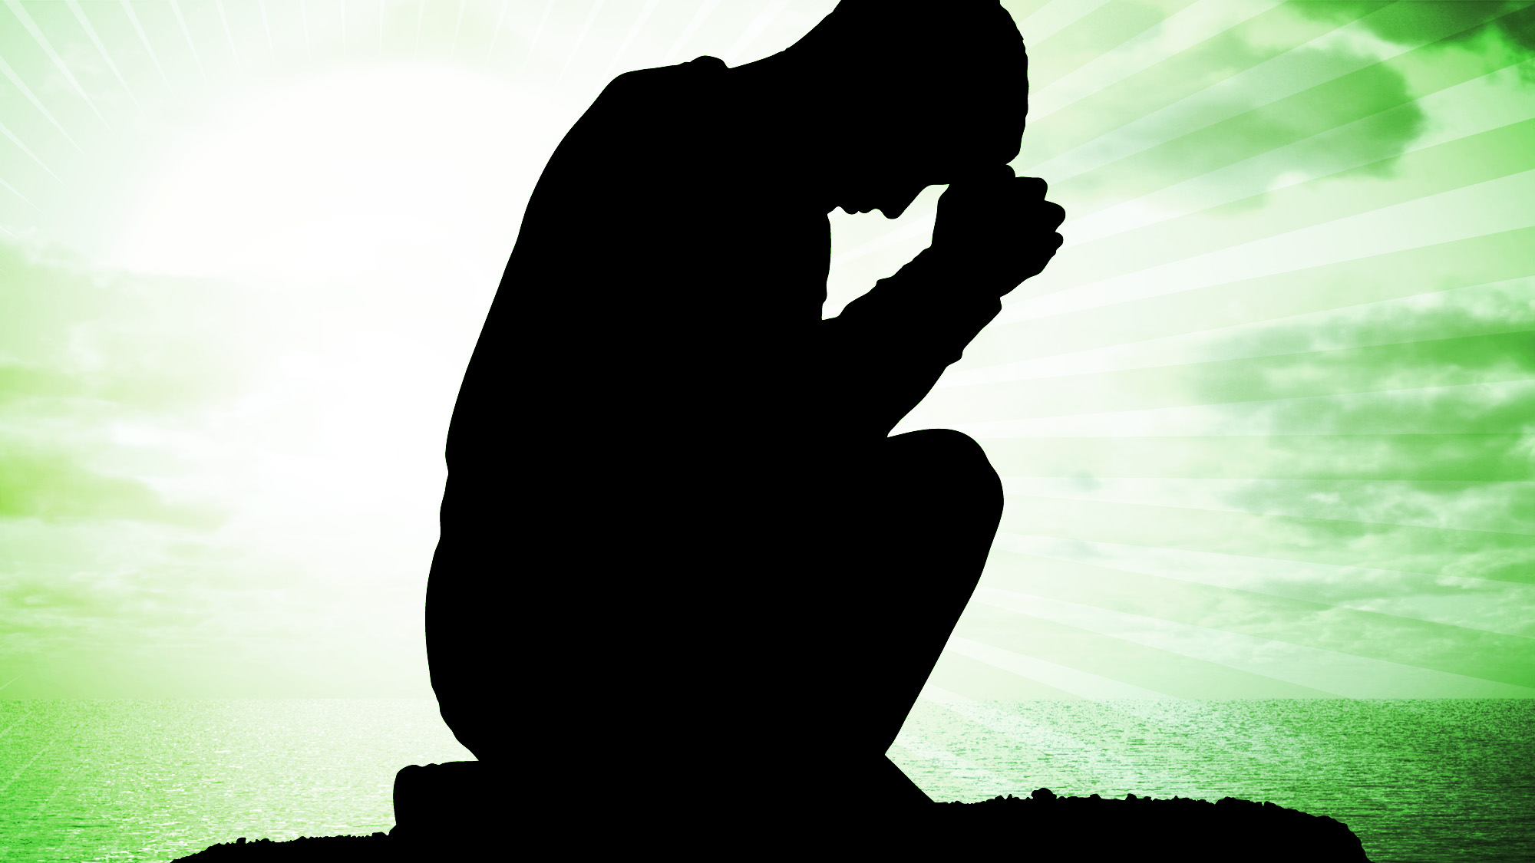
LORD,
I want to
Change!

Slide 7
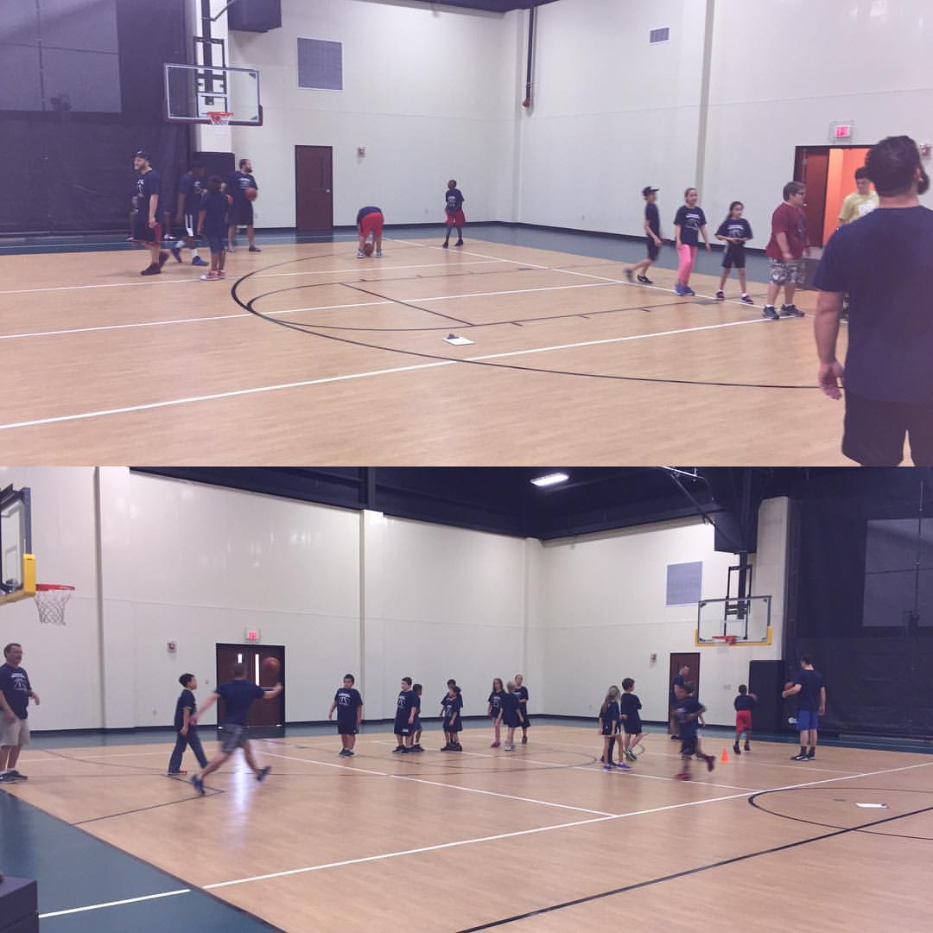

Slide 8
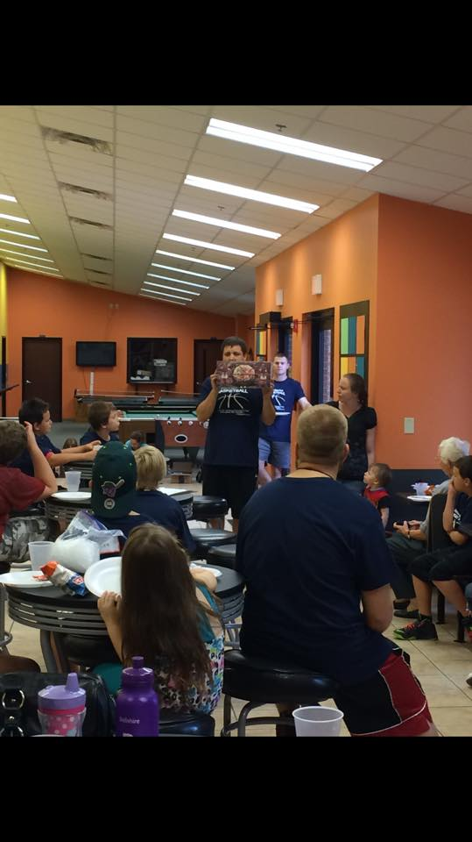

Slide 9
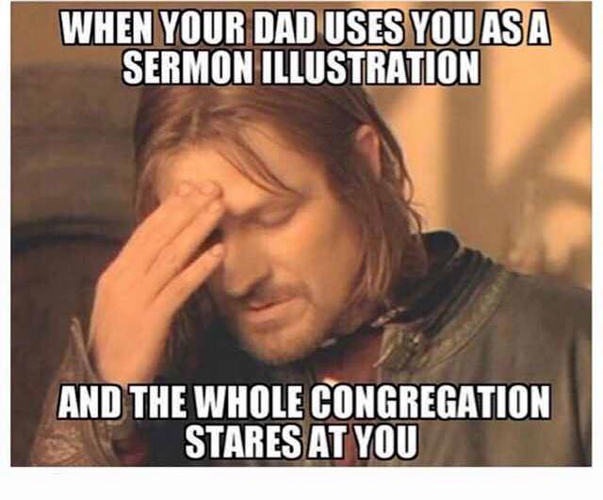

Slide 10
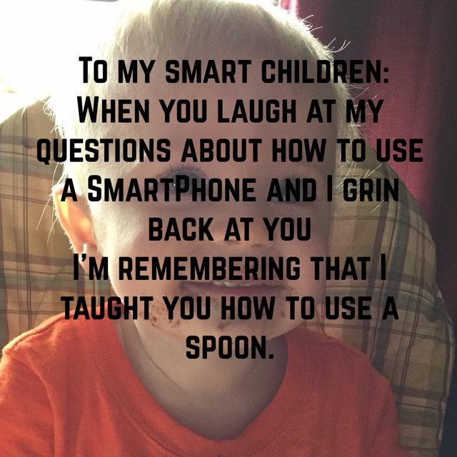

Slide 11
LORD,
I want to
Change!

Slide 12
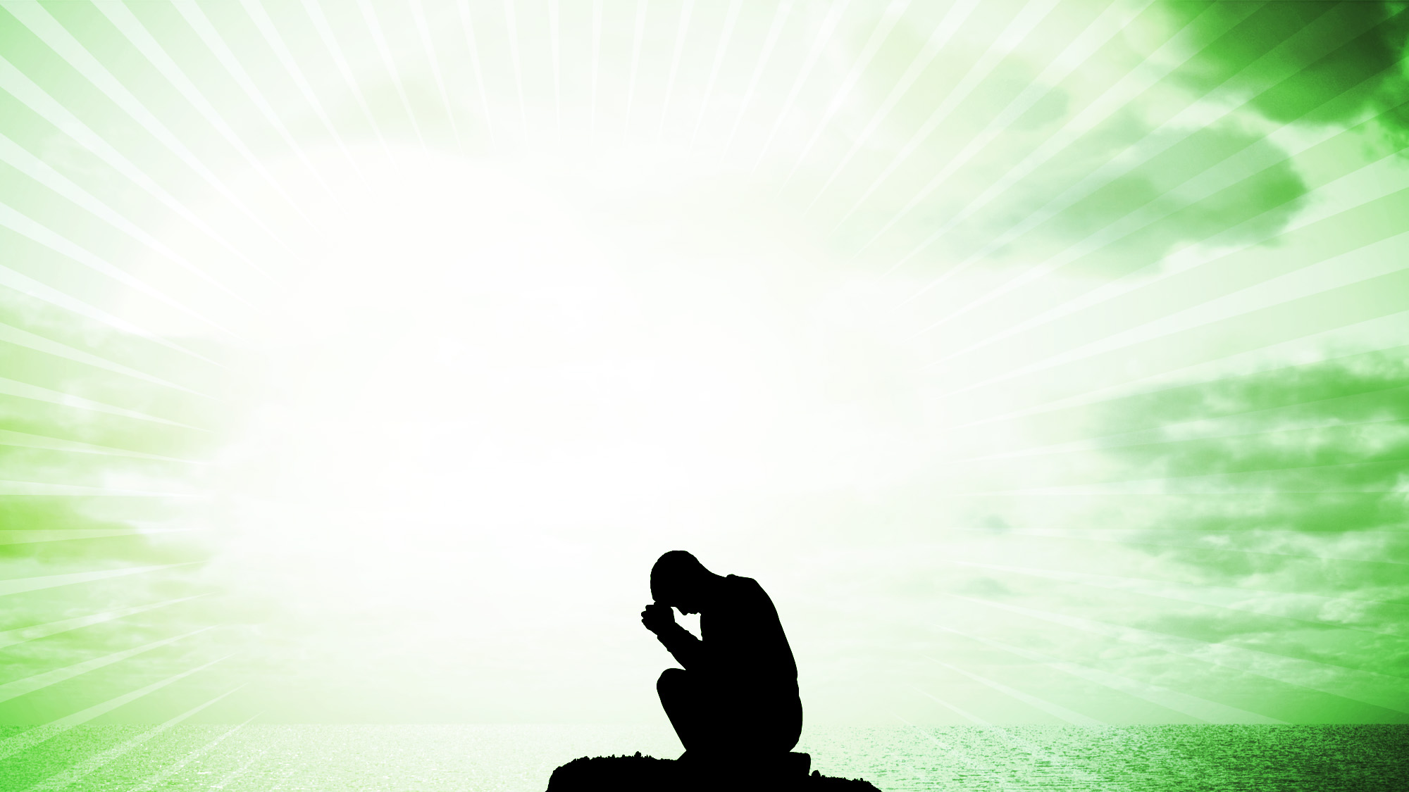
Colossians 1:7
just as you learned it from Epaphras, our beloved
fellow bond-servant, who is a faithful servant of
Christ on our behalf,

Slide 13
Colossea Believers:
They exhibited some fruit in their lives.

Slide 14
Colossea Believers:
They exhibited some fruit in their lives.
Paul wanted more for them!

Slide 15
Colossea Believers:
They exhibited some fruit in their lives.
Paul wanted more for them!
Paul didn’t want them to fall back into old ways.

Slide 16
Cultural Challenges in Colossea

Slide 17
Cultural Challenges in Colossea
For Salvation – Jesus plus human works.

Slide 18
Cultural Challenges in Colossea
For Salvation – Jesus plus human works.
Human Philosophy based on traditions of men.

Slide 19
Cultural Challenges in Colossea
For Salvation – Jesus plus human works.
Human Philosophy based on traditions of men.
Native Phrygian religion with cultic and Eastern
mysticism added to the mix.

Slide 20
Cultural Challenges in Colossea
For Salvation – Jesus plus human works.
Human Philosophy based on traditions of men.
Native Phrygian religion with cultic and Eastern
mysticism added to the mix.
Flesh is evil and to be controlled by rigorous
physical disciplines.

Slide 21
Cultural Challenges in Colossea
For Salvation – Jesus plus human works.
Human Philosophy based on traditions of men.
Native Phrygian religion with cultic and Eastern
mysticism added to the mix.
Flesh is evil and to be controlled by rigorous
physical disciplines.
Angel Worship.

Slide 22
Colossians 1:15 – 17
¹⁵ And He is the image of the invisible God, the first-born of all creation. ¹⁶ For by Him all things were created, both in the heavens and on earth, visible and invisible, whether thrones or dominions or rulers or authorities – all things have been created by Him and for Him. ¹⁷ And He is before all things, and in Him all things hold together.

Slide 23
Colossians 1:15 – 17
¹⁵ And He is the image of the invisible God, the first-born of all creation. ¹⁶ For by Him all things were created, both in the heavens and on earth, visible and invisible, whether thrones or dominions or rulers or authorities – all things have been created by Him and for Him. ¹⁷ And He is before all things, and in Him all things hold together.

Slide 24
Colossians 1:18 – 20
¹⁸ He is also head of the body, the church; and He is the beginning, the first-born from the dead; so that He Himself might come to have first place in everything. ¹⁹ For it was the Father’s good pleasure for all the fullness to dwell in Him, ²⁰ and through Him to reconcile all things to Himself, having made peace through the blood of His cross; through Him, I say, whether things on earth or things in heaven.

Slide 25
Colossians 1:18 – 20
¹⁸ He is also head of the body, the church; and He is the beginning, the first-born from the dead; so that He Himself might come to have first place in everything. ¹⁹ For it was the Father’s good pleasure for all the fullness to dwell in Him, ²⁰ and through Him to reconcile all things to Himself, having made peace through the blood of His cross; through Him, I say, whether things on earth or things in heaven.

Slide 26
Colossians 1:18 – 20
¹⁸ He is also head of the body, the church; and He is the beginning, the first-born from the dead; so that He Himself might come to have first place in everything. ¹⁹ For it was the Father’s good pleasure for all the fullness to dwell in Him, ²⁰ and through Him to reconcile all things to Himself, having made peace through the blood of His cross; through Him, I say, whether things on earth or things in heaven.

Slide 27
Colossians 1:18 – 20
¹⁸ He is also head of the body, the church; and He is the beginning, the first-born from the dead; so that He Himself might come to have first place in everything. ¹⁹ For it was the Father’s good pleasure for all the fullness to dwell in Him, ²⁰ and through Him to reconcile all things to Himself, having made peace through the blood of His cross; through Him, I say, whether things on earth or things in heaven.

Slide 28
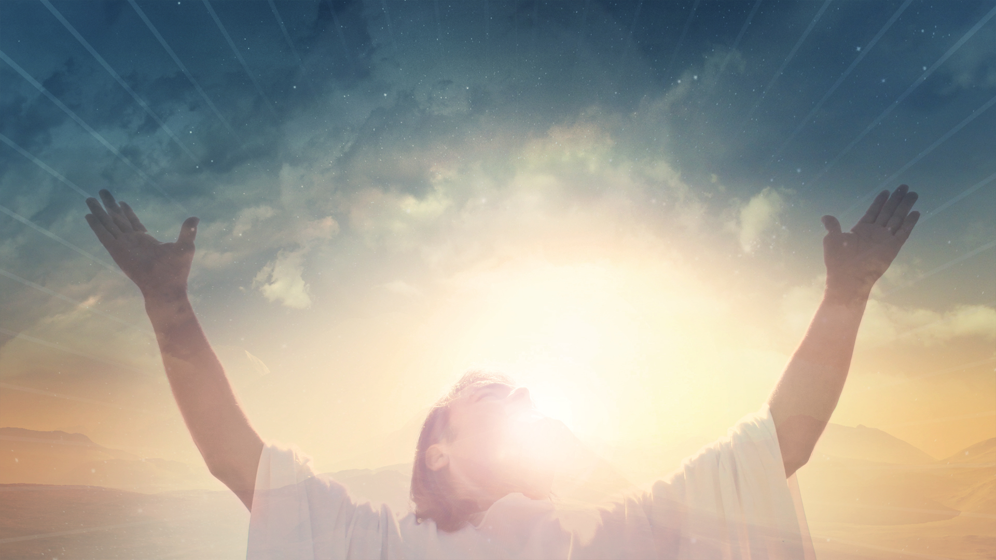
He Is:
Priority!

Slide 29
He Is:
Priority! Preeminent!

Slide 30
He Is:
Priority! Preeminent! King of All of you Life!

Slide 31
Prince of Peace
Son of Man

Slide 32
Lamb of God
The Great I Am

Slide 33
Two Things Reveal Your Priorities

Slide 34
Two Things Reveal Your Priorities
Your Calendar and Your Checkbook!

Slide 35
Lord, I want to change!
First Change:
Make Jesus the Lord of your life.

Slide 36
Colossians 1:9
For this reason also, since the day we heard of it,
we have not ceased to pray for you and to ask that
you may be filled with the knowledge of His will
in all spiritual wisdom and understanding.

Slide 37
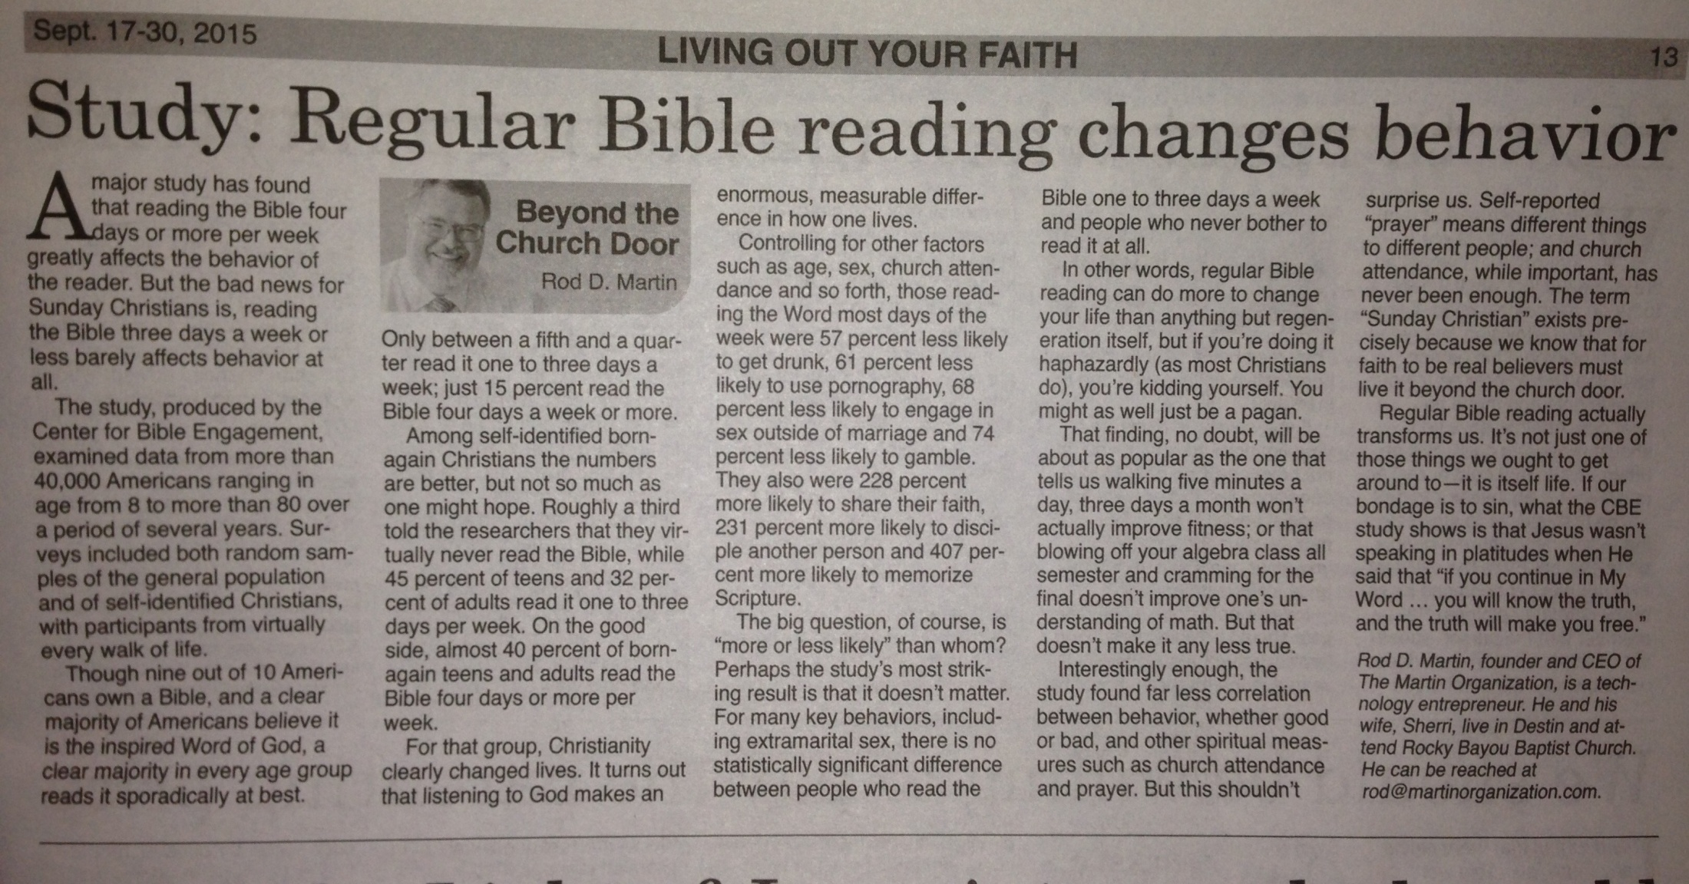

Slide 38
Colossians 1:9
For this reason also, since the day we heard of it,
we have not ceased to pray for you and to ask that
you may be filled with the knowledge of His will
in all spiritual wisdom and understanding.

Slide 39
Lord, I want to change!
First Change:
Make Jesus the Lord of your life.
Second Change:
Determine to know God’s will and to do God’s
will.

Slide 40
Colossians 1:10
so that you may walk in a manner worthy of the
Lord, to please Him in all respects, bearing fruit in
every good work and increasing in the knowledge
of God;

Slide 41
What does it mean to bear fruit?

Slide 42
What does it mean to bear fruit?
John 15:8
“My Father is glorified by this, that you bear
much fruit, and so prove to be My disciples.”

Slide 43
What does it mean to bear fruit?
Galatians 5:22-23
But the fruit of the Spirit is love, joy, peace,
patience, kindness, goodness, faithfulness,
gentleness, self-control, against such things there
is no law.

Slide 44
Christ follower = changed life

Slide 45
Christ follower = changed life
What is real obedience?

Slide 46
Christ follower = changed life
What is real obedience?
Obeying all the way, right away and with the
right heart attitude.

Slide 47
Colossians 1:11
strengthened with all power, according to His
glorious might, for the attaining of all
steadfastness and patience, joyously

Slide 48
Colossians 1:12-14
giving thanks to the Father, who has qualified
us to share in the inheritance of the saints in
light. ¹³ For He delivered us from the domain of
darkness, and transferred us to the kingdom of
His beloved Son, ¹⁴ in whom we have
redemption, the
forgiveness of sins.

Slide 49
Walking Worthy

Slide 50
Walking Worthy
Bearing Fruit

Slide 51
Walking Worthy
Bearing Fruit
Increasing in the knowledge of God

Slide 52
Walking Worthy
Bearing Fruit
Increasing in the knowledge of God
Strengthened with God’s power to joyfully
endure trials with a sweet spirit

Slide 53
Walking Worthy
Bearing Fruit
Increasing in the knowledge of God
Strengthened with God’s power to joyfully
endure trials with a sweet spirit
Giving thanks to the Father

Slide 54
LORD,
I want to
Change!

