Slide 2
Jesus commanded John Write the things which you have seen, and the things which are, and the things which will take place after this. (Rev. 1:19) Chapter 4 begins the section of the book that tells us what takes place “after this,” after the age of the church.

Slide 3
Jesus commanded John Write the things which you have seen, and the things which are, and the things which will take place after this. (Rev. 1:19) Chapter 4 begins the section of the book that tells us what takes place “after this,” after the age of the church.

Slide 4
Revelation 4:1 After these things I looked, and behold, a door standing open in heaven. And the first voice which I heard was like a trumpet speaking with me, saying, “Come up here, and I will show you things which must take place after this.”

Slide 5
John´s journey to heaven is an advance picture of the rapture of the church when all believers, dead and alive, shall rise to meet the Lord in the air and be carried back to heaven with Jesus.

Slide 6
John´s journey to heaven is an advance picture of the rapture of the church when all believers, dead and alive, shall rise to meet the Lord in the air and be carried back to heaven with Jesus.

Slide 7
Oh what a sight awaited the apostle as he was brought into the Throne Room of Heaven. We will pause to read the whole account in John 4, but will print the verses in parts to keep them close to our examination of them.

Slide 8
Oh what a sight awaited the apostle as he was brought into the Throne Room of Heaven. We will pause to read the whole account in John 4, but will print the verses in parts to keep them close to our examination of them.

Slide 9
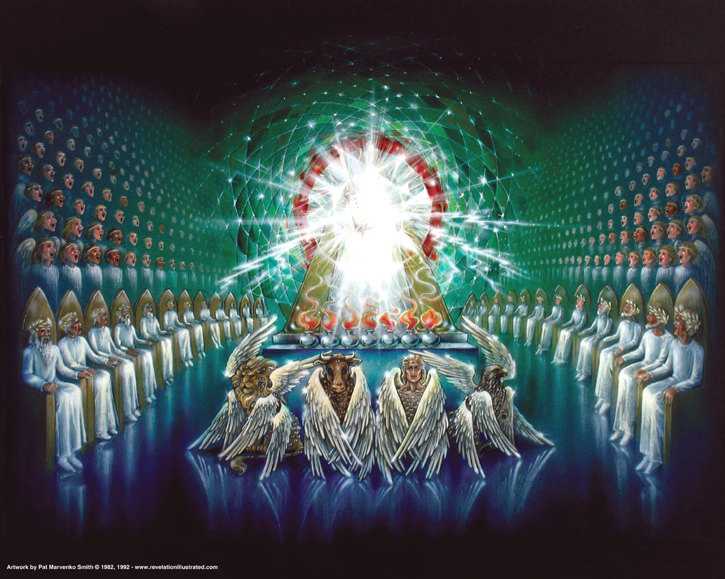
Revelation 4:2–11
² Immediately I was in the Spirit; and behold, a throne set in heaven, and One sat on the throne.

Slide 10
Revelation 4:2–11
³ And He who sat there was like a jasper and a sardius stone in appearance; and there was a rainbow around the throne, in appearance like an emerald.

Slide 11
There is One Seated on the Throne
Who is this? God the Father (Verses 8 and 11, tell us it is God, and in 5:6, we find the Son standing by the throne. In verse 5 we see the Spirit is before the throne.) The three precious gems named have characteristics which refer to God’s glory.
Jasper – clear – the purity of God (Rev. 21:11, 18-19)
Sardius (Carnelian) – red (color of blood) – God´s righteousness and wrath
Emerald – green – the grace and mercy of God (Ps 52:8)

Slide 12
There is One Seated on the Throne
Who is this? God the Father (Verses 8 and 11, tell us it is God, and in 5:6, we find the Son standing by the throne. In verse 5 we see the Spirit is before the throne.) The three precious gems named have characteristics which refer to God’s glory.
Jasper – clear – the purity of God (Rev. 21:11, 18-19)
Sardius (Carnelian) – red (color of blood) – God´s righteousness and wrath
Emerald – green – the grace and mercy of God (Ps 52:8)

Slide 13
There is One Seated on the Throne
Who is this? God the Father (Verses 8 and 11, tell us it is God, and in 5:6, we find the Son standing by the throne. In verse 5 we see the Spirit is before the throne.) The three precious gems named have characteristics which refer to God’s glory.
Jasper – clear – the purity of God (Rev. 21:11, 18-19)
Sardius (Carnelian) – red (color of blood) – God´s righteousness and wrath
Emerald – green – the grace and mercy of God (Ps 52:8)

Slide 14
There is One Seated on the Throne
Who is this? God the Father (Verses 8 and 11, tell us it is God, and in 5:6, we find the Son standing by the throne. In verse 5 we see the Spirit is before the throne.) The three precious gems named have characteristics which refer to God’s glory.
Jasper – clear – the purity of God (Rev. 21:11, 18-19)
Sardius (Carnelian) – red (color of blood) – God´s righteousness and wrath
Emerald – green – the grace and mercy of God (Ps 52:8)

Slide 15
There is One Seated on the Throne
Who is this? God the Father (Verses 8 and 11, tell us it is God, and in 5:6, we find the Son standing by the throne. In verse 5 we see the Spirit is before the throne.) The three precious gems named have characteristics which refer to God’s glory.
Jasper – clear – the purity of God (Rev. 21:11, 18-19)
Sardius (Carnelian) – red (color of blood) – God´s righteousness and wrath
Emerald – green – the grace and mercy of God (Ps 52:8)

Slide 16
There is One Seated on the Throne
Who is this? God the Father (Verses 8 and 11, tell us it is God, and in 5:6, we find the Son standing by the throne. In verse 5 we see the Spirit is before the throne.) The three precious gems named have characteristics which refer to God’s glory.
Jasper – clear – the purity of God (Rev. 21:11, 18-19)
Sardius (Carnelian) – red (color of blood) – God´s righteousness and wrath
Emerald – green – the grace and mercy of God (Ps 52:8)

Slide 17
There is One Seated on the Throne
Who is this? God the Father (Verses 8 and 11, tell us it is God, and in 5:6, we find the Son standing by the throne. In verse 5 we see the Spirit is before the throne.) The three precious gems named have characteristics which refer to God’s glory.
Jasper – clear – the purity of God (Rev. 21:11, 18-19)
Sardius (Carnelian) – red (color of blood) – God´s righteousness and wrath
Emerald – green – the grace and mercy of God (Ps 52:8)

Slide 18
There is One Seated on the Throne
Who is this? God the Father (Verses 8 and 11, tell us it is God, and in 5:6, we find the Son standing by the throne. In verse 5 we see the Spirit is before the throne.) The three precious gems named have characteristics which refer to God’s glory.
Jasper – clear – the purity of God (Rev. 21:11, 18-19)
Sardius (Carnelian) – red (color of blood) – God´s righteousness and wrath
Emerald – green – the grace and mercy of God (Ps 52:8)

Slide 19
God on His Throne is the focal point of everything in the room.
Everything else in the room is described in relation to the throne.
The 24 Elders are around the throne.
Lightning and thunder came from the throne.
Seven lamps of fire are before the throne.
The Crystal Sea is before the throne.
The four Living Creatures are around the throne.

Slide 20
God on His Throne is the focal point of everything in the room.
Everything else in the room is described in relation to the throne.
The 24 Elders are around the throne.
Lightning and thunder came from the throne.
Seven lamps of fire are before the throne.
The Crystal Sea is before the throne.
The four Living Creatures are around the throne.

Slide 21
God on His Throne is the focal point of everything in the room.
Everything else in the room is described in relation to the throne.
The 24 Elders are around the throne.
Lightning and thunder came from the throne.
Seven lamps of fire are before the throne.
The Crystal Sea is before the throne.
The four Living Creatures are around the throne.

Slide 22
God on His Throne is the focal point of everything in the room.
Everything else in the room is described in relation to the throne.
The 24 Elders are around the throne.
Lightning and thunder came from the throne.
Seven lamps of fire are before the throne.
The Crystal Sea is before the throne.
The four Living Creatures are around the throne.

Slide 23
God on His Throne is the focal point of everything in the room.
Everything else in the room is described in relation to the throne.
The 24 Elders are around the throne.
Lightning and thunder came from the throne.
Seven lamps of fire are before the throne.
The Crystal Sea is before the throne.
The four Living Creatures are around the throne.

Slide 24
As we visualize the throne room of heaven, we are not daydreaming or picturing a wishful fantasy. We are visualizing that which is. We are hearing reality described. In spite of the desires of our ever rebellious hearts, this universe is centered upon God. God created it. God sustains it. God controls it.

Slide 25
There is a rainbow surrounding the throne.
This is not a mere portion of it, but a full circle rainbow encircling the throne.
The rainbow is a testimony that God keeps His promises. (Gen. 9:8-17)
“I will never leave you or forsake you.”
Even when I walk through the valley of the shadow of death, You are with me.

Slide 26
There is a rainbow surrounding the throne.
This is not a mere portion of it, but a full circle rainbow encircling the throne.
The rainbow is a testimony that God keeps His promises. (Gen. 9:8-17)
“I will never leave you or forsake you.”
Even when I walk through the valley of the shadow of death, You are with me.

Slide 27
There is a rainbow surrounding the throne.
This is not a mere portion of it, but a full circle rainbow encircling the throne.
The rainbow is a testimony that God keeps His promises. (Gen. 9:8-17)
“I will never leave you or forsake you.”
Even when I walk through the valley of the shadow of death, You are with me.

Slide 28
Revelation 4:4, 10 Around the throne were twenty-four thrones, and on the thrones I saw twenty-four elders sitting, clothed in white robes; and they had crowns of gold on their heads. …

Slide 29
Revelation 4:4, 10 10 the twenty-four elders fall down before Him who sits on the throne and worship Him who lives forever and ever, and cast their crowns before the throne, saying:

Slide 30
There are Elders Around the Throne (4:4, 10; 5:5, 8-12)
What do we know about these elders?
They are 24 in number.
They each have a throne and crown.
They are dressed in white garments.
They worship God and the Lamb.

Slide 31
There are Elders Around the Throne (4:4, 10; 5:5, 8-12)
What do we know about these elders?
They are 24 in number.
They each have a throne and crown.
They are dressed in white garments.
They worship God and the Lamb.

Slide 32
There are Elders Around the Throne (4:4, 10; 5:5, 8-12)
What do we know about these elders?
They are 24 in number.
They each have a throne and crown.
They are dressed in white garments.
They worship God and the Lamb.

Slide 33
There are Elders Around the Throne (4:4, 10; 5:5, 8-12)
What do we know about these elders?
They are 24 in number.
They each have a throne and crown.
They are dressed in white garments.
They worship God and the Lamb.

Slide 34
There are Elders Around the Throne (4:4, 10; 5:5, 8-12)
What do we know about these elders?
They are 24 in number.
They each have a throne and crown.
They are dressed in white garments.
They worship God and the Lamb.

Slide 35
There are Elders Around the Throne (4:4, 10; 5:5, 8-12)
What do we know about these elders?
They are 24 in number.
They each have a throne and crown.
They are dressed in white garments.
They worship God and the Lamb.

Slide 36
Who are the elders?
The best suggestion is that the elders are the representatives of the Old and New Testament saints. In the Old Testament, there were 24 courses or groups of priests (1 Chr. 24:3-5, 18) that served in the temple. Here 24 believers serve in heaven. They are clothed in white which represents the righteousness of Christ (Rev. 7:13-14). They wear victors’ crowns which believers will receive as rewards at the Judgment Seat of Christ.

Slide 37
Who are the elders?
The best suggestion is that the elders are the representatives of the Old and New Testament saints. In the Old Testament, there were 24 courses or groups of priests (1 Chr. 24:3-5, 18) that served in the temple. Here 24 believers serve in heaven. They are clothed in white which represents the righteousness of Christ (Rev. 7:13-14). They wear victors’ crowns which believers will receive as rewards at the Judgment Seat of Christ.

Slide 38
Revelation 4:5 And from the throne proceeded lightnings, thunderings, and voices. Seven lamps of fire were burning before the throne, which are the seven Spirits of God.

Slide 39
We have previously identified the seven Spirits of God as the seven-fold Spirit of God, or the Holy Spirit in all of His fullness.

Slide 40
We have previously identified the seven Spirits of God as the seven-fold Spirit of God, or the Holy Spirit in all of His fullness.

Slide 41
We have previously identified the seven Spirits of God as the seven-fold Spirit of God, or the Holy Spirit in all of His fullness.

Slide 42
Revelation 4:6–8 Before the throne there was a sea of glass, like crystal. And in the midst of the throne, and around the throne, were four living creatures full of eyes in front and in back.

Slide 43
7 The first living creature was like a lion, the second living creature like a calf, the third living creature had a face like a man, and the fourth living creature was like a flying eagle.

Slide 44
8 The four living creatures, each having six wings, were full of eyes around and within. And they do not rest day or night, saying:

Slide 45
“Holy, holy, holy,
Lord God Almighty,
Who was and is and is to come!”

Slide 46
There are Four Living Creatures Around the Throne
They have six wings, but still have two hands.
They have eyes everywhere, front, back, over, under, … everywhere.
Ezekiel saw them also, and he calls them cherubim; and he adds
They had calf-like feet.
Each one had four faces: lion, eagle, man, and ox

Slide 47
There are Four Living Creatures Around the Throne
They have six wings, but still have two hands.
They have eyes everywhere, front, back, over, under, … everywhere.
Ezekiel saw them also, and he calls them cherubim; and he adds
They had calf-like feet.
Each one had four faces: lion, eagle, man, and ox

Slide 48
There are Four Living Creatures Around the Throne
They have six wings, but still have two hands.
They have eyes everywhere, front, back, over, under, … everywhere.
Ezekiel saw them also, and he calls them cherubim; and he adds
They had calf-like feet.
Each one had four faces: lion, eagle, man, and ox

Slide 49
There are Four Living Creatures Around the Throne
They have six wings, but still have two hands.
They have eyes everywhere, front, back, over, under, … everywhere.
Ezekiel saw them also, and he calls them cherubim; and he adds
They had calf-like feet.
Each one had four faces: lion, eagle, man, and ox

Slide 50
There are Four Living Creatures Around the Throne
They have six wings, but still have two hands.
They have eyes everywhere, front, back, over, under, … everywhere.
Ezekiel saw them also, and he calls them cherubim; and he adds
They had calf-like feet.
Each one had four faces: lion, eagle, man, and ox

Slide 51
There are Four Living Creatures Around the Throne
They have six wings, but still have two hands.
They have eyes everywhere, front, back, over, under, … everywhere.
Ezekiel saw them also, and he calls them cherubim; and he adds
They had calf-like feet.
Each one had four faces: lion, eagle, man, and ox

Slide 52
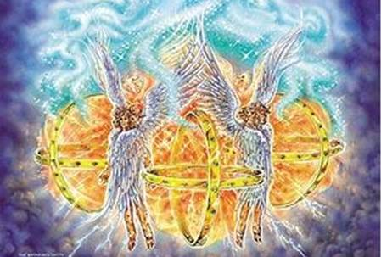
Ezekiel 1:13–20 13 As for the likeness of the living creatures, their appearance was like burning coals of fire, like the appearance of torches going back and forth among the living creatures. The fire was bright, and out of the fire went lightning.

Slide 53
14 And the living creatures ran back and forth, in appearance like a flash of lightning.

Slide 54
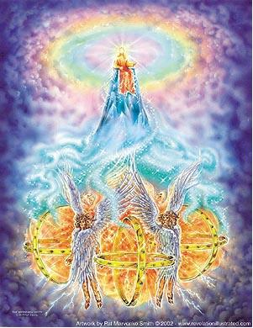
15 Now as I looked at the living creatures, behold, a wheel was on the earth beside each living creature with its four faces.

Slide 55
16 The appearance of the wheels and their workings was like the color of beryl, and all four had the same likeness. The appearance of their workings was, as it were, a wheel in the middle of a wheel.

Slide 56
17 When they moved, they went toward any one of four directions; they did not turn aside when they went. 18 As for their rims, they were so high they were awesome; and their rims were full of eyes, all around the four of them.

Slide 57
19 When the living creatures went, the wheels went beside them; and when the living creatures were lifted up from the earth, the wheels were lifted up.

Slide 58
20 Wherever the spirit wanted to go, they went, because there the spirit went; and the wheels were lifted together with them, for the spirit of the living creatures was in the wheels.

Slide 59
Notice the Other Objects Before the Throne (4:5-6; 6:9-11; 8:3-5)
Rev. 4:5-6 5 And from the throne proceeded lightnings, thunderings, and voices. Seven lamps of fire were burning before the throne, which are the seven Spirits of God. 6 Before the throne there was a sea of glass, like crystal. And in the midst of the throne, and around the throne, were four living creatures full of eyes in front and in back.

Slide 60
Notice the Other Objects Before the Throne (4:5-6; 6:9-11; 8:3-5)
Rev. 6:9 When He opened the fifth seal, I saw under the altar the souls of those who had been slain for the word of God and for the testimony which they held.

Slide 61
Notice the Other Objects Before the Throne (4:5-6; 6:9-11; 8:3-5)
Rev. 8:3-4 3 Then another angel, having a golden censer, came and stood at the altar. He was given much incense, that he should offer it with the prayers of all the saints upon the golden altar which was before the throne. 4 And the smoke of the incense, with the prayers of the saints, ascended before God from the angel’s hand.

Slide 62
Here in the Throne Room of Heaven, we find
The Altar of Sacrifice (6:9-11)
The Sea of Glass (4:6)
The Altar of Incense (8:3-5)

Slide 63
Here in the Throne Room of Heaven, we find
The Altar of Sacrifice (6:9-11)
The Sea of Glass (4:6)
The Altar of Incense (8:3-5)

Slide 64
Here in the Throne Room of Heaven, we find
The Altar of Sacrifice (6:9-11)
The Sea of Glass (4:6)
The Altar of Incense (8:3-5)

Slide 65
Here in the Throne Room of Heaven, we find
The Altar of Sacrifice (6:9-11)
The Sea of Glass (4:6)
The Altar of Incense (8:3-5)

Slide 66
Do these things sound familiar? They should. They were all things in the tabernacle. You see, in Exodus 24, God brought Moses and the elders up Mt. Sinai, and from there they could all see the throne of God. They saw lightning and heard the thunder coming from the throne. They saw the brilliant fiery light proceeding from the throne of the Almighty.

Slide 67
Do these things sound familiar? They should. They were all things in the tabernacle. You see, in Exodus 24, God brought Moses and the elders up Mt. Sinai, and from there they could all see the throne of God. They saw lightning and heard the thunder coming from the throne. They saw the brilliant fiery light proceeding from the throne of the Almighty.

Slide 68
But then, God told everybody to stay put, except Moses. He told Moses to climb up higher on the mountain, and He said to Moses,
Exodus 25:8–9 8 And let them make Me a sanctuary, that I may dwell among them. 9 According to all that I show you, that is, the pattern of the tabernacle and the pattern of all its furnishings, just so you shall make it.

Slide 69
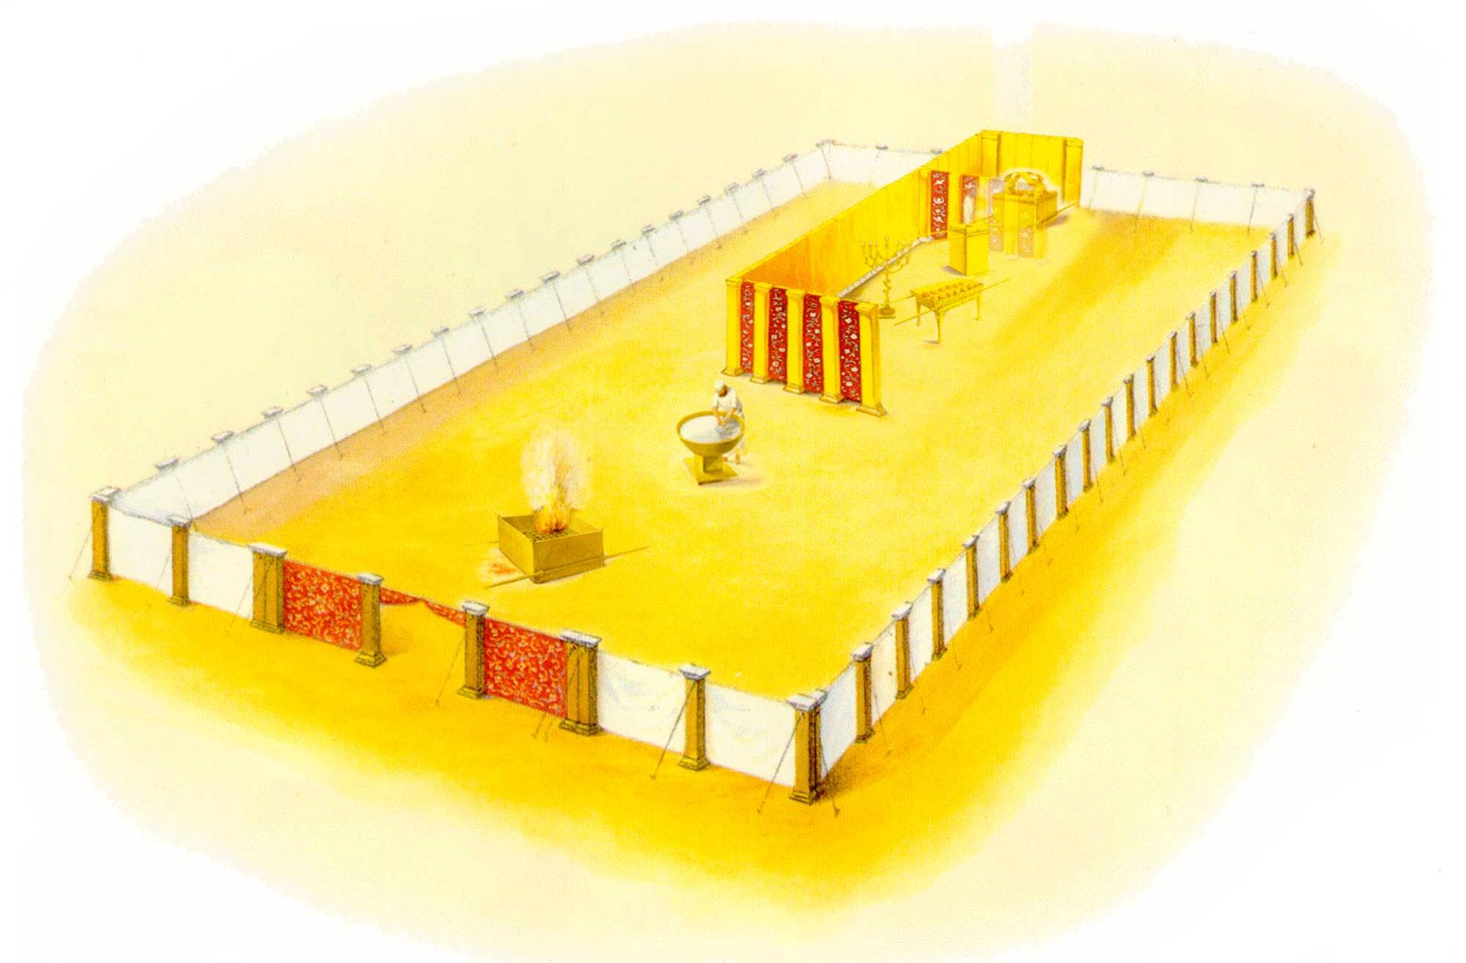
God told Moses to build the tabernacle like the Throne Room of Heaven and everything within it would point people to God´s Heavenly Home.

Slide 70
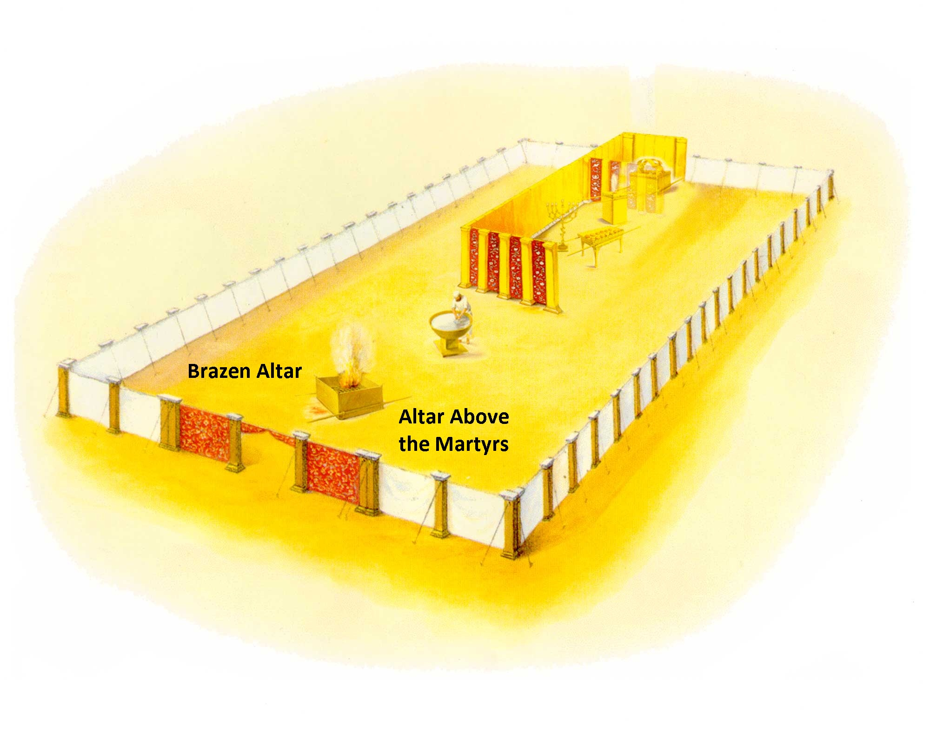
The Brazen Altar where The Altar over the martyrs in heaven is.

Slide 71
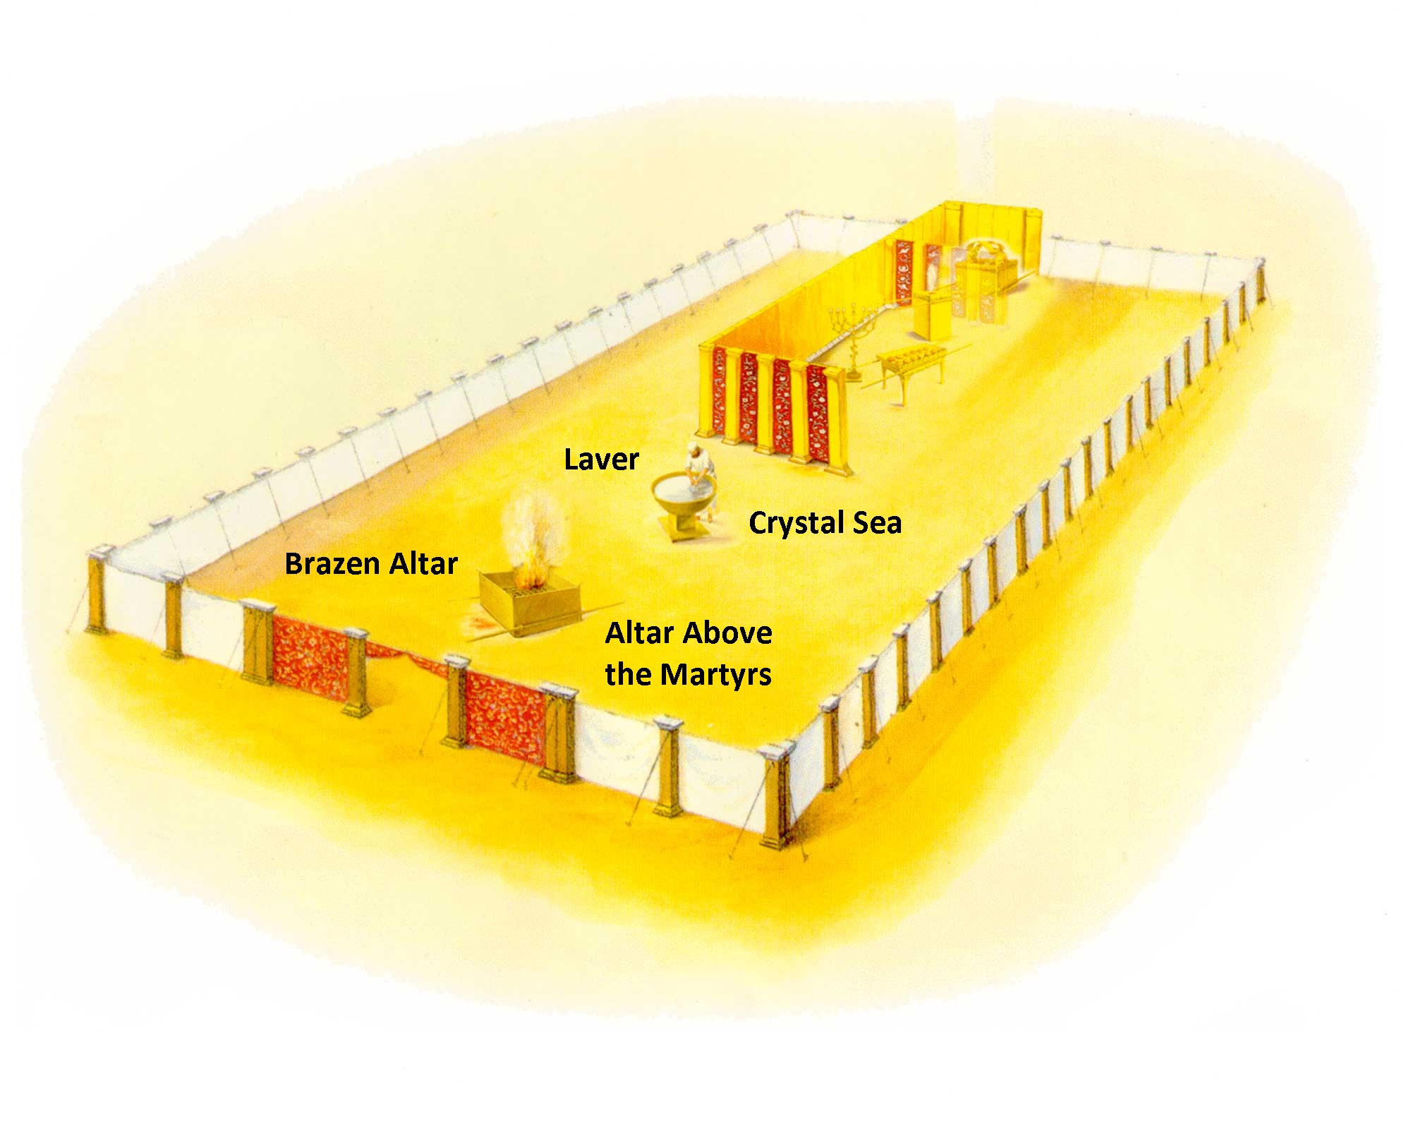
The Laver in the place of the Sea of Glass, the Crystal Sea.

Slide 72
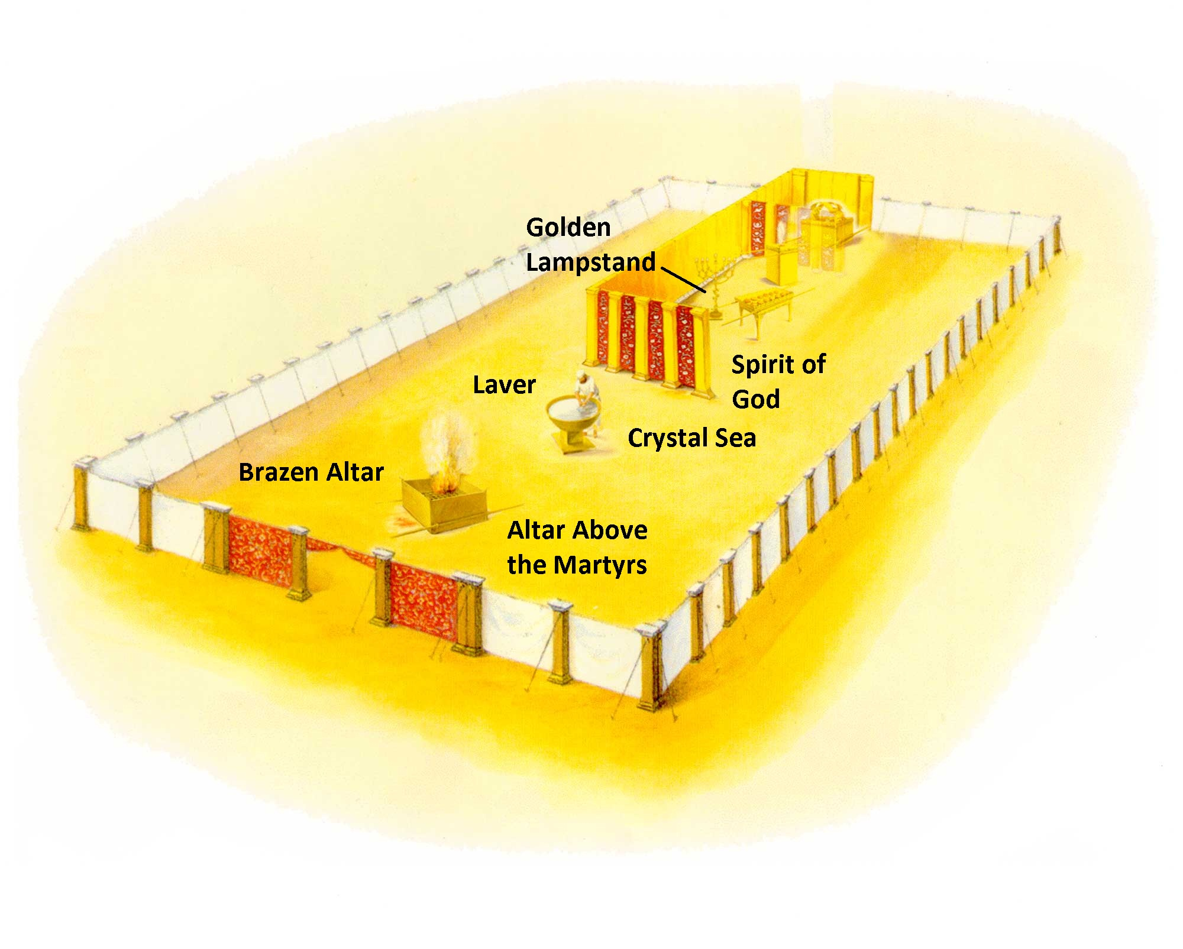
The Golden Lampstand picturing the Seven Fold Spirit of God.

Slide 73
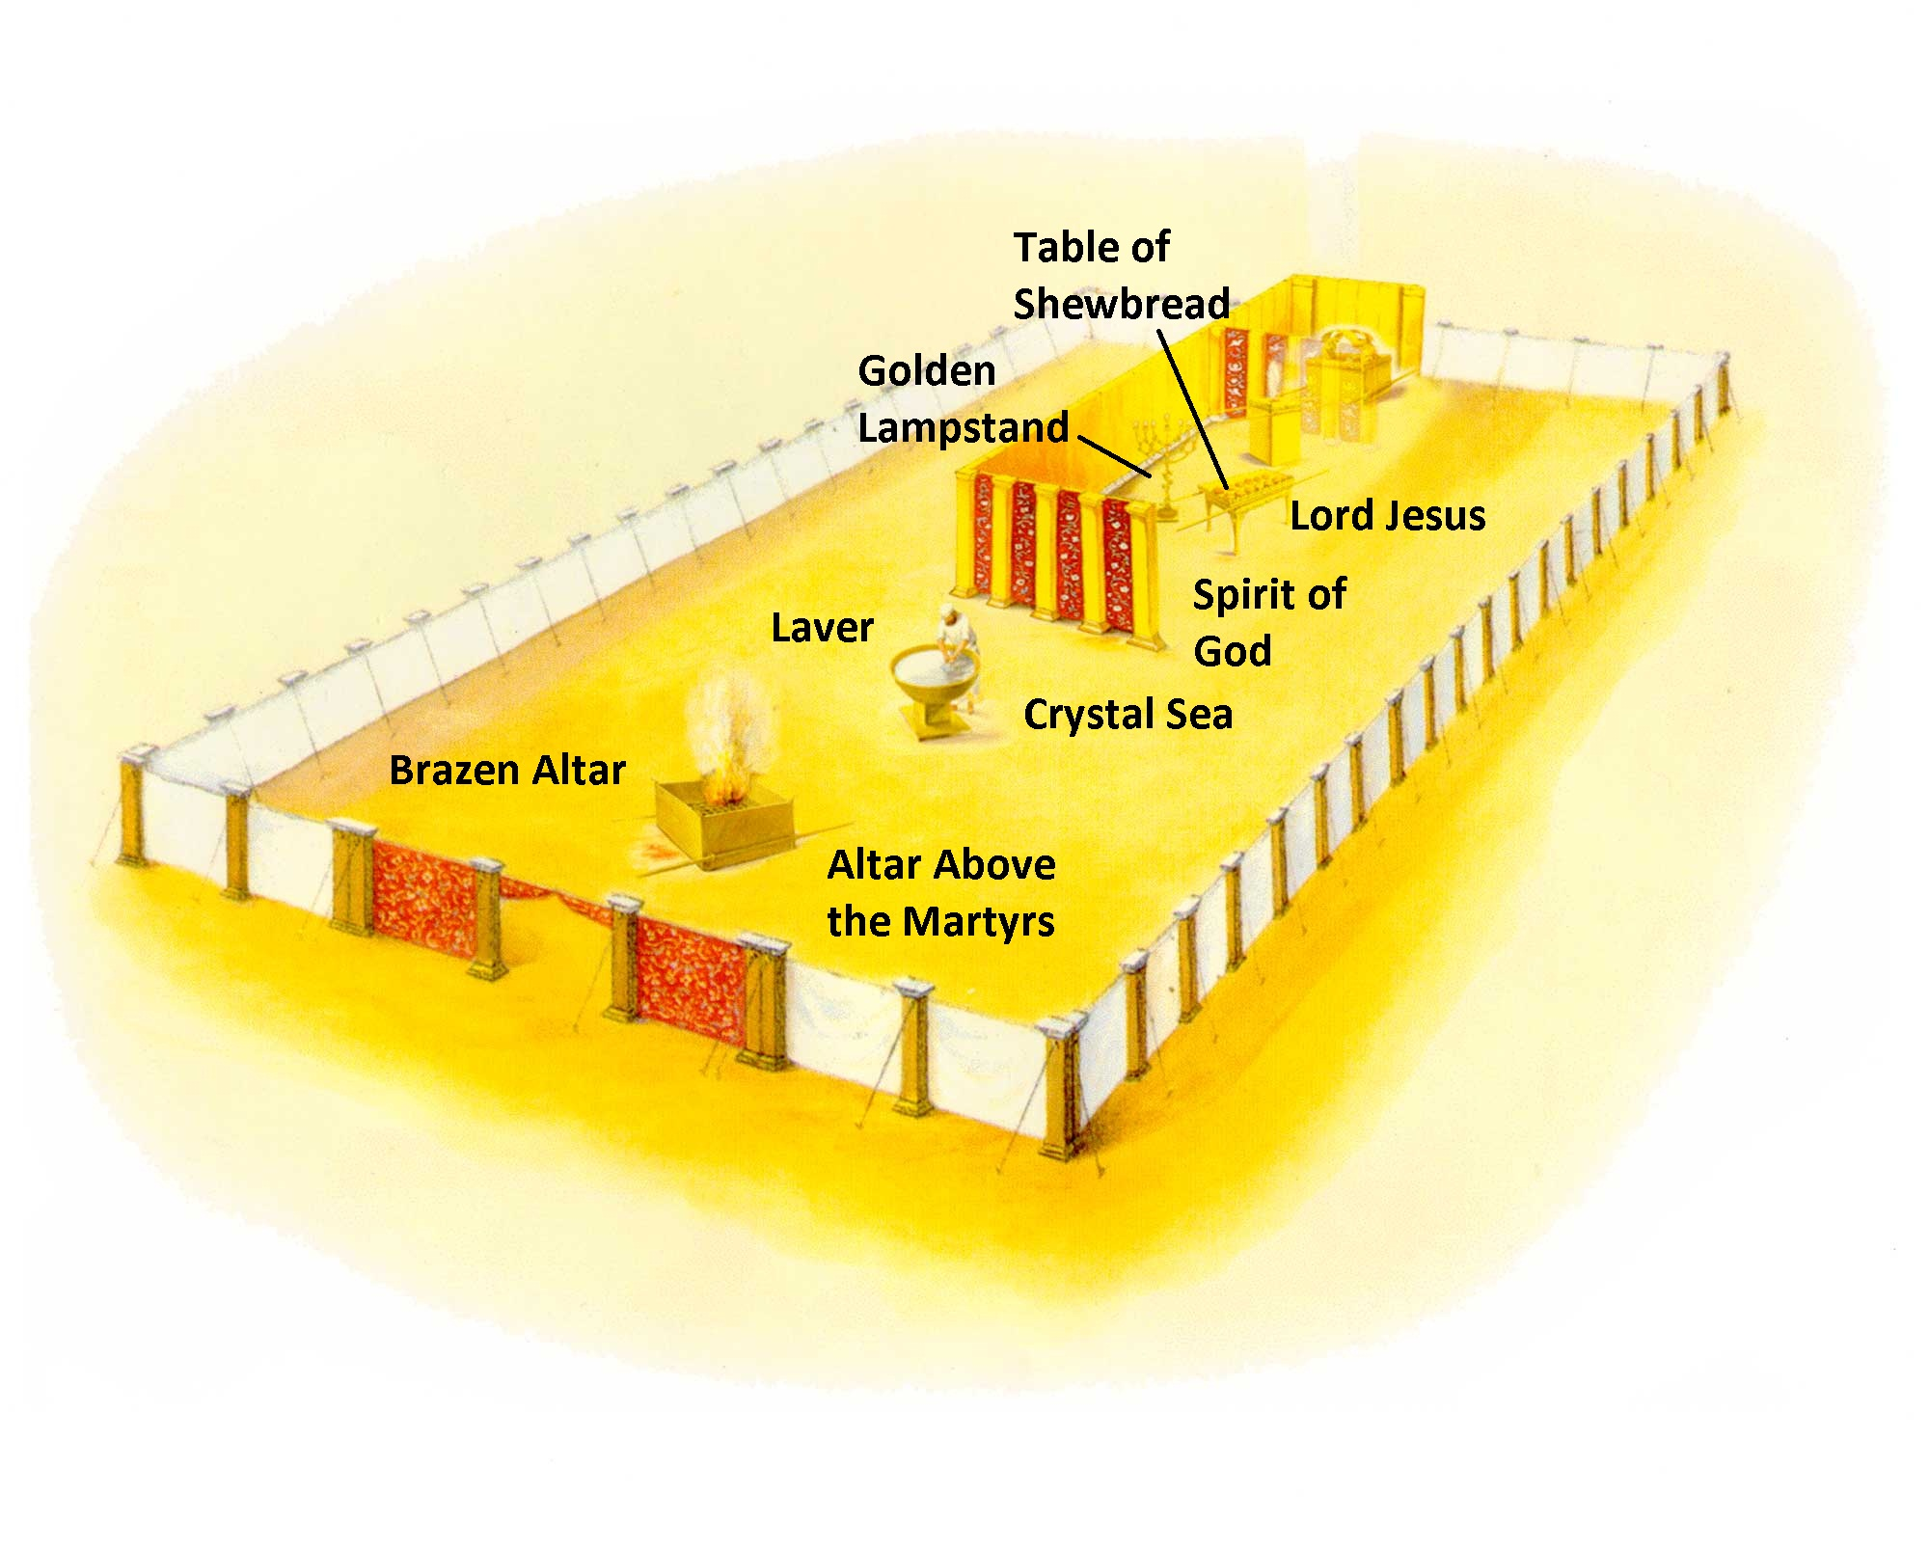
The Table of the Shewbread where the Lord Jesus is standing as we shall see in the next chapter.

Slide 74
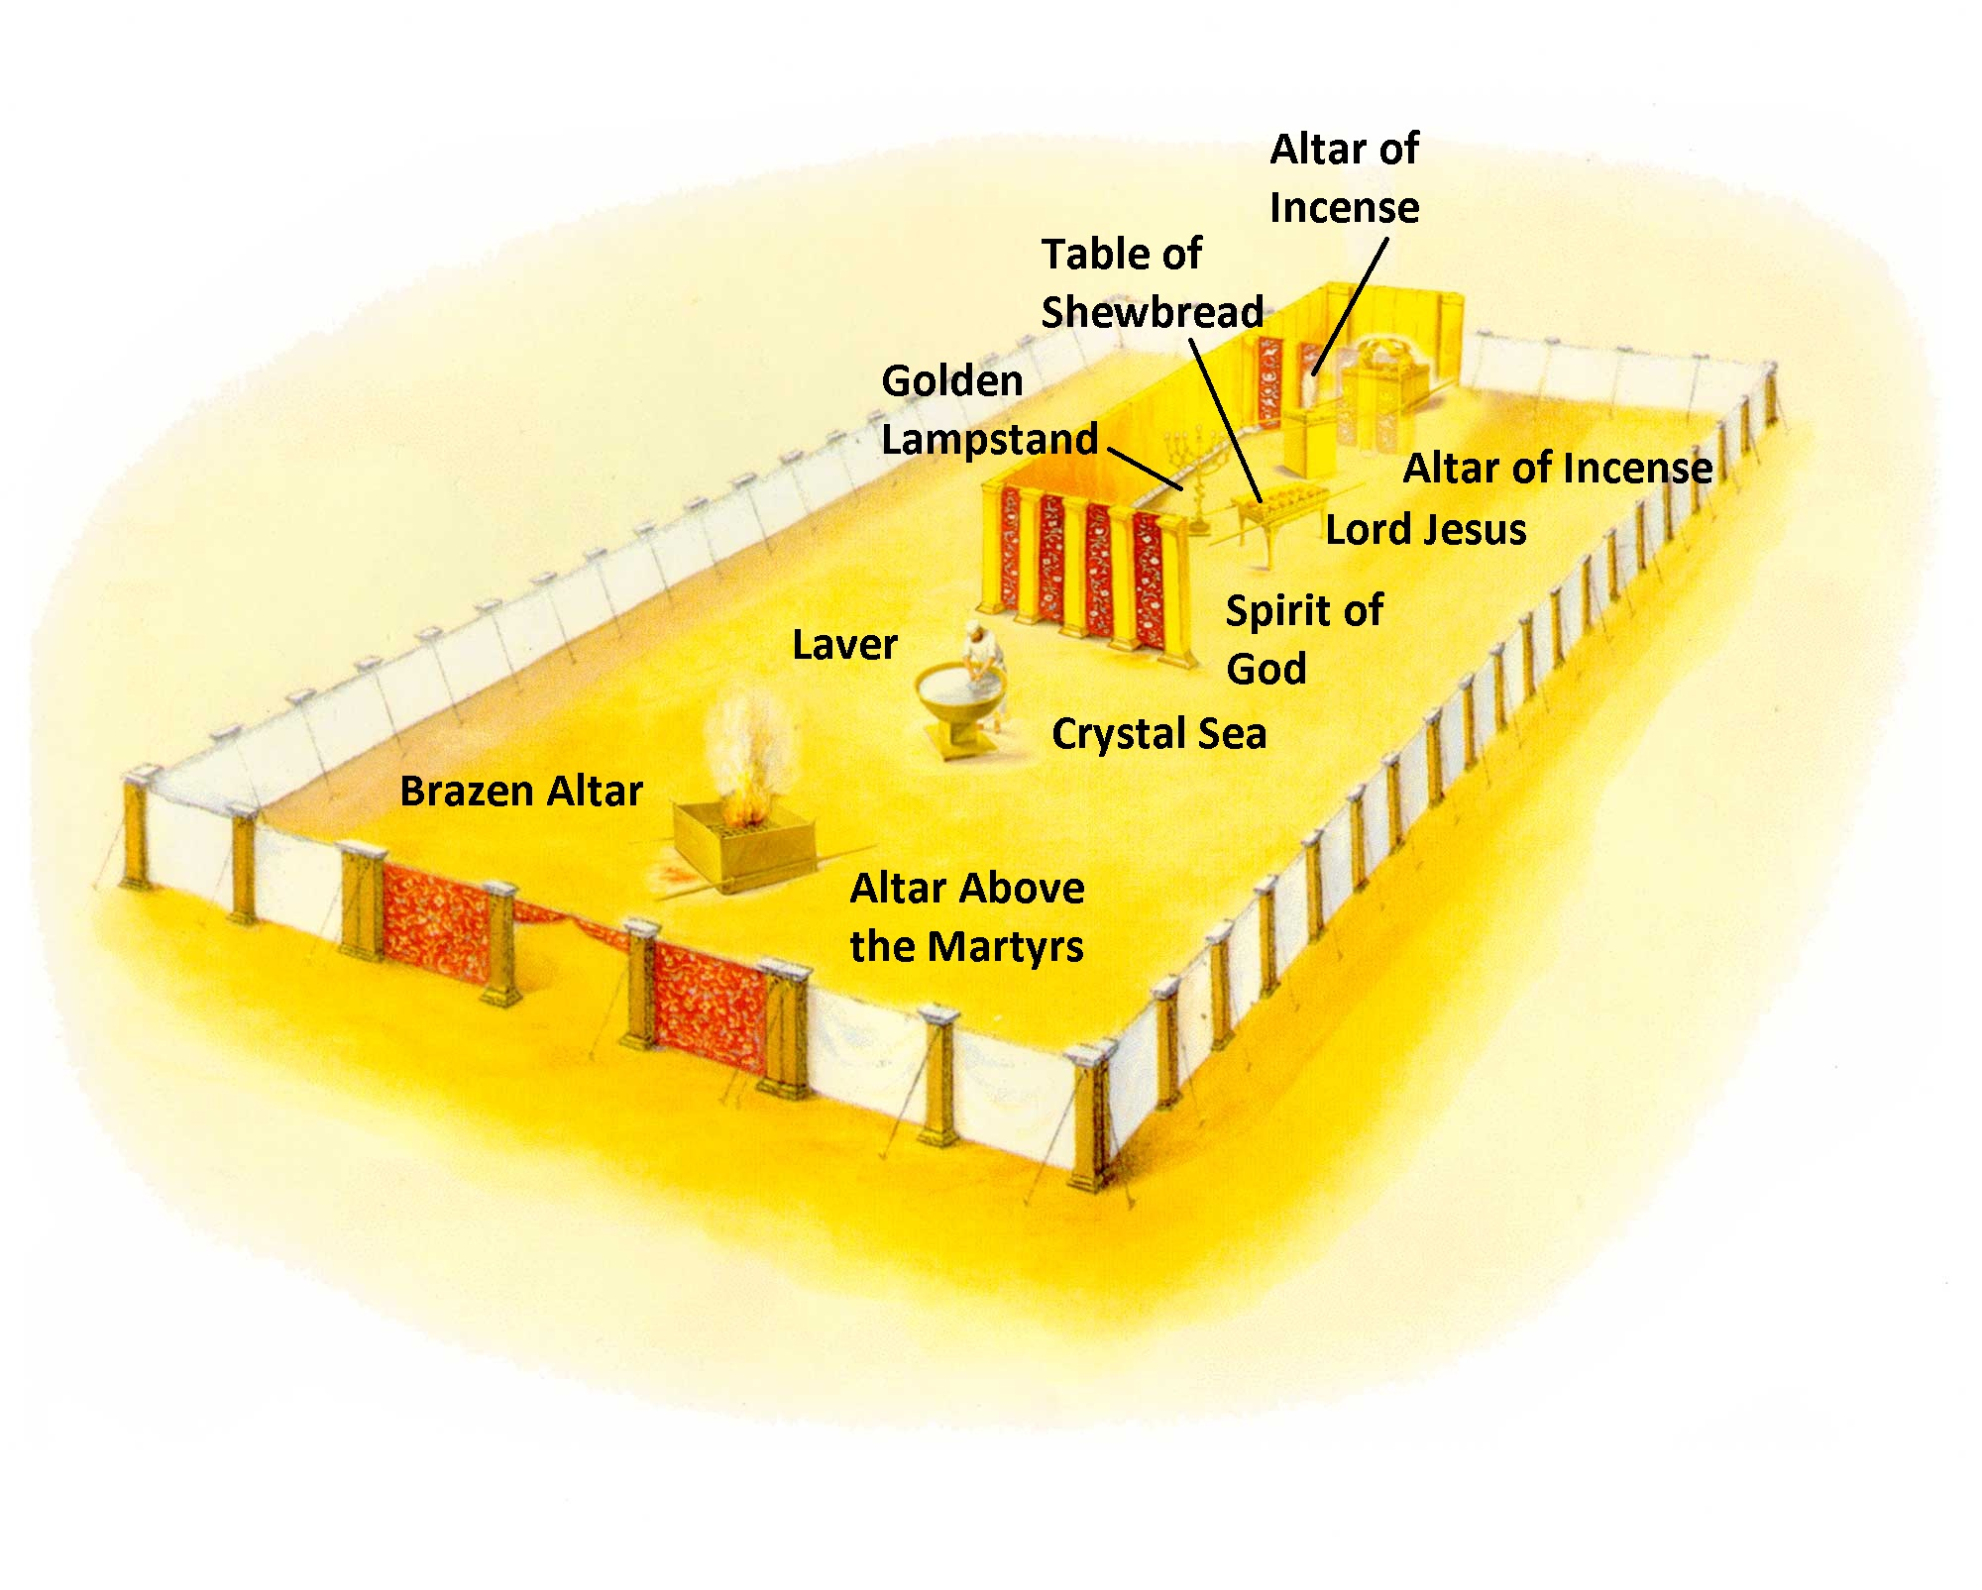
The Altar of Incense where the Heavenly Altar of Incense is placed before the Almighty.

Slide 75
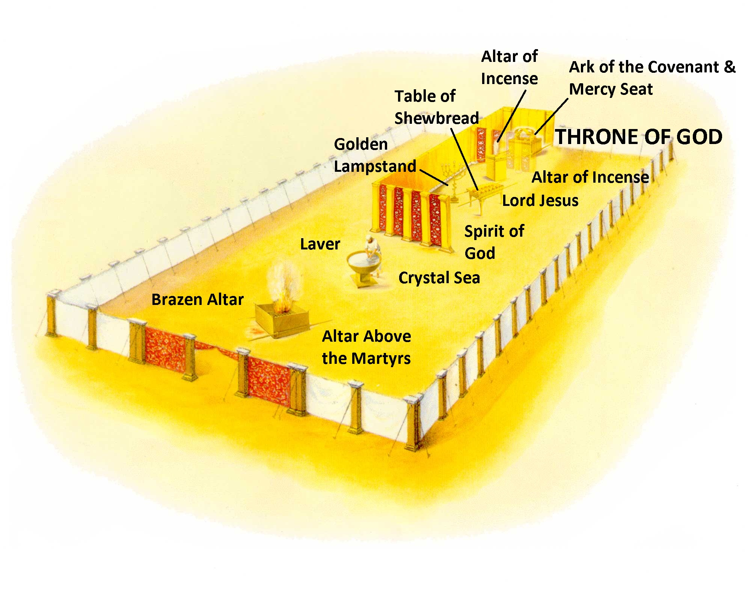
And the Ark of the Covenant with the Mercy Seat on top in the location where rests the Throne of God.

Slide 76
Now, one final thing. Do you see the pattern? What do you have when you look at the pattern of all these things in the tabernacle? The cross!

Slide 77
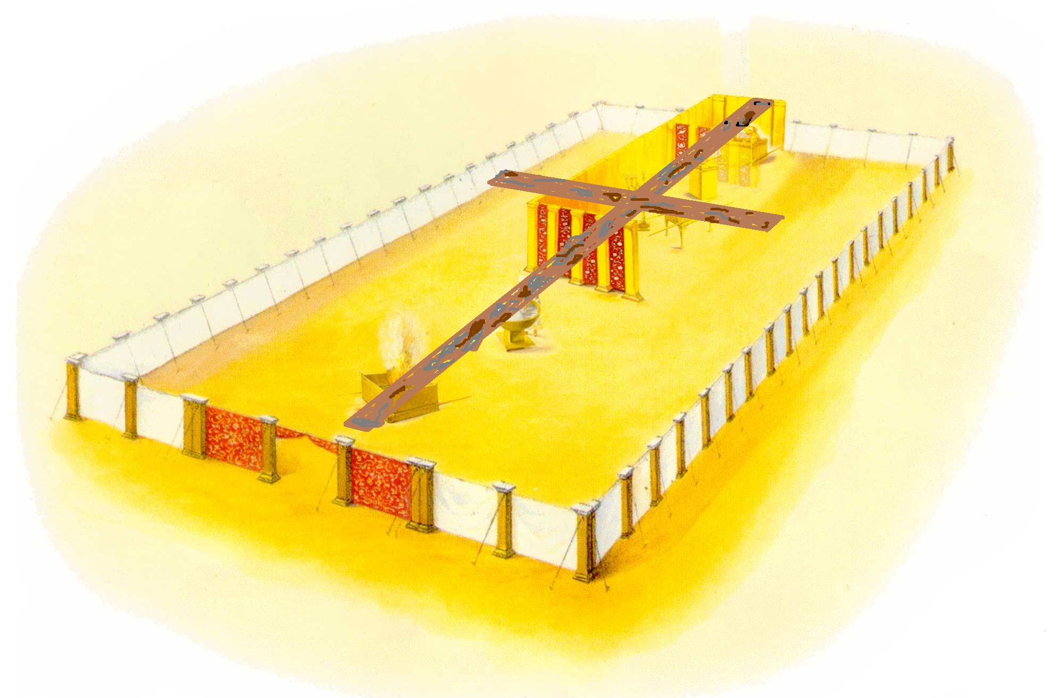
Now, one final thing. Do you see the pattern? What do you have when you look at the pattern of all these things in the tabernacle? The cross!

Slide 78
CONCLUSION: My dear friend, far more significant than the fact that the implements in the Tabernacle form the shape of the cross, is the fact that this is the pattern in Heaven´s Throne Room.
The only way to heaven is by way of the cross.

Slide 79
CONCLUSION: My dear friend, far more significant than the fact that the implements in the Tabernacle form the shape of the cross, is the fact that this is the pattern in Heaven´s Throne Room.
The only way to heaven is by way of the cross.

Slide 80
CONCLUSION: My dear friend, far more significant than the fact that the implements in the Tabernacle form the shape of the cross, is the fact that this is the pattern in Heaven´s Throne Room.
The only way to heaven is by way of the cross.

Slide 81
John 14:6 Jesus said to him, “I am the way, the truth, and the life. No one comes to the Father except through Me.

