Slide 2
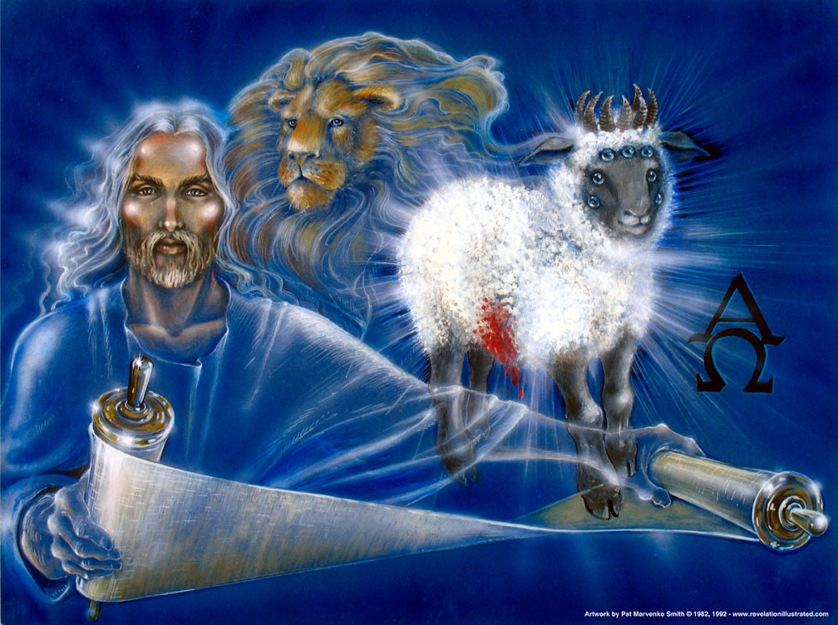
In Revelation Chapter 5, the Apostle John saw the Risen Christ, the Lamb of God, take the Title Deed of Creation, the Scroll of Destiny from the hand of God the Father.

Slide 3
In Revelation Chapter 5, the Apostle John saw the Risen Christ, the Lamb of God, take the Title Deed of Creation, the Scroll of Destiny from the hand of God the Father.

Slide 4
In the presence of the Four Living Creatures, forever crying “Holy, Holy, Holy,” before the Twenty-four Elders to fall on their faces and give worship to the Lamb, and before all the holy angels of heaven who joined in the worship of all creation, the Exalted Christ began to break the seven seals upon the scroll one by one.

Slide 5
In the presence of the Four Living Creatures, forever crying “Holy, Holy, Holy,” before the Twenty-four Elders to fall on their faces and give worship to the Lamb, and before all the holy angels of heaven who joined in the worship of all creation, the Exalted Christ began to break the seven seals upon the scroll one by one.

Slide 6
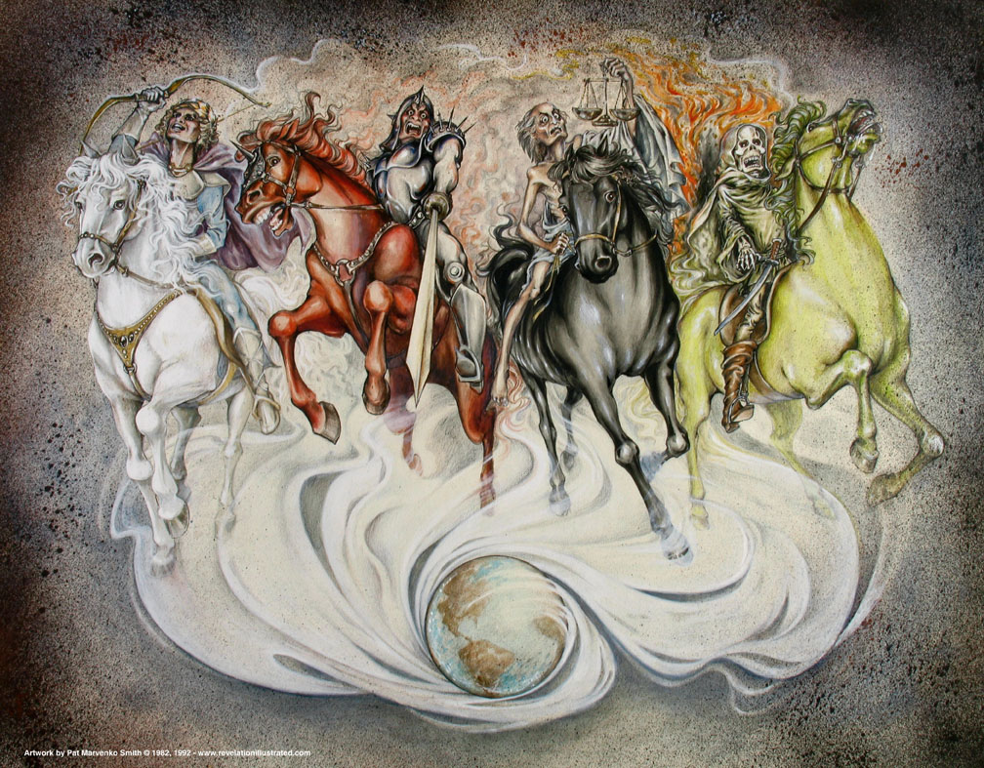
The breaking of the first six seals set in motion that seven year period of time known as the tribulation and brought great judgments upon the earth.

Slide 7
The breaking of the first six seals set in motion that seven year period of time known as the tribulation and brought great judgments upon the earth.

Slide 8
These judgments were severe in their extent but benevolent in their purpose. They served to awaken men from the stupor of their self absorption and from the blindness of Satan´s deceit to realize that there really is a Righteous God Who is Sovereign in Heaven and His Son is Jesus Who is called the Lamb of God because He gave His life upon the cross to pay the price for the sins of mankind.

Slide 9
These judgments were severe in their extent but benevolent in their purpose. They served to awaken men from the stupor of their self absorption and from the blindness of Satan´s deceit to realize that there really is a Righteous God Who is Sovereign in Heaven and His Son is Jesus Who is called the Lamb of God because He gave His life upon the cross to pay the price for the sins of mankind.

Slide 10
These judgments were severe in their extent but benevolent in their purpose. They served to awaken men from the stupor of their self absorption and from the blindness of Satan´s deceit to realize that there really is a Righteous God Who is Sovereign in Heaven and His Son is Jesus Who is called the Lamb of God because He gave His life upon the cross to pay the price for the sins of mankind.

Slide 11
These judgments were severe in their extent but benevolent in their purpose. They served to awaken men from the stupor of their self absorption and from the blindness of Satan´s deceit to realize that there really is a Righteous God Who is Sovereign in Heaven and His Son is Jesus Who is called the Lamb of God because He gave His life upon the cross to pay the price for the sins of mankind.

Slide 12
These judgments were severe in their extent but benevolent in their purpose. They served to awaken men from the stupor of their self absorption and from the blindness of Satan´s deceit to realize that there really is a Righteous God Who is Sovereign in Heaven and His Son is Jesus Who is called the Lamb of God because He gave His life upon the cross to pay the price for the sins of mankind.

Slide 13
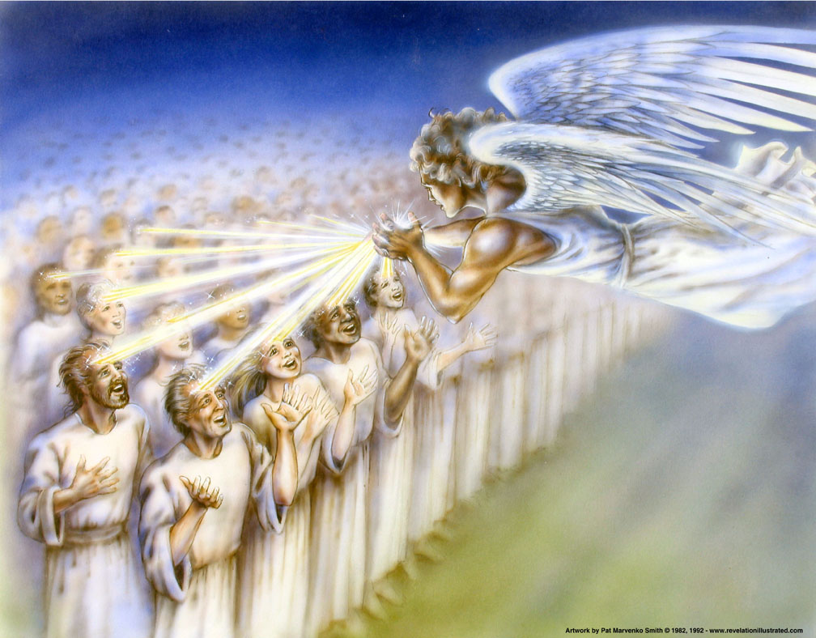
While the judgments grabbed the attention of mankind, God sent a clear message of the gospel, through 144,000 Jewish witnesses who carried those saving words around the globe.

Slide 14
While the judgments grabbed the attention of mankind, God sent a clear message of the gospel, through 144,000 Jewish witnesses who carried those saving words around the globe.

Slide 15
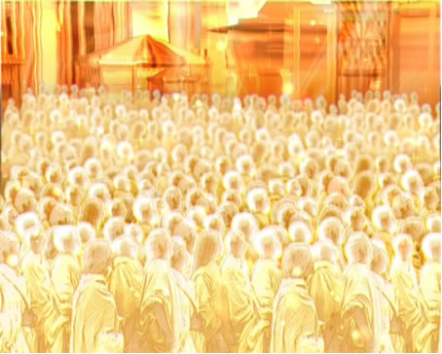
The result of it all was the salvation of a great multitude of people from every tribe, tongue, and nation.

Slide 16
The result of it all was the salvation of a great multitude of people from every tribe, tongue, and nation.

Slide 17
The result of it all was the salvation of a great multitude of people from every tribe, tongue, and nation.

Slide 18
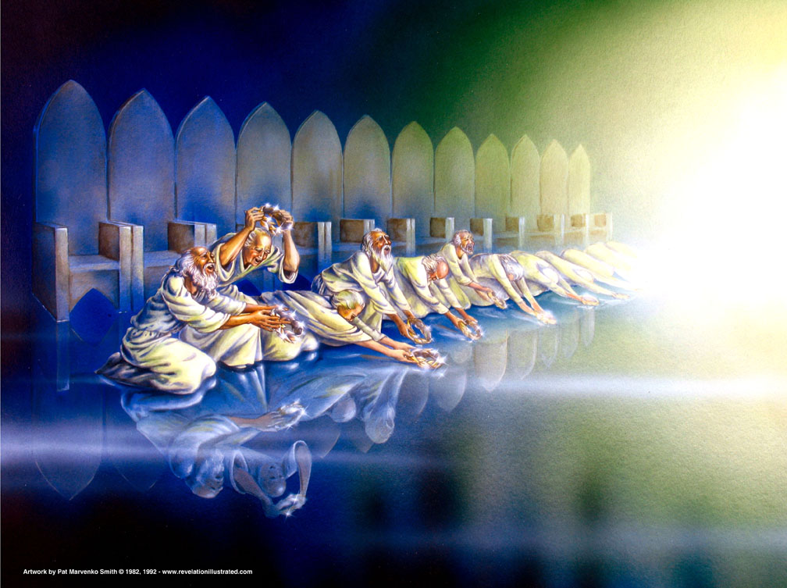
Chapter 8 of The Revelation opens with one seal left intact upon the Scroll of Destiny.

Slide 19
Chapter 8 of The Revelation opens with one seal left intact upon the Scroll of Destiny.

Slide 20
Chapter 8 of The Revelation opens with one seal left intact upon the Scroll of Destiny.
Revelation 8:1 When He opened the seventh seal, there was silence in heaven for about half an hour.

Slide 21
Why this reaction among the heavenly host and the saints of God when the seventh seal is broken? Let´s use our tools for interpretation and figure this out.
Remember we are reading the Bible, the Word of God.
Allow the Bible to speak for itself.
Observe the context.
Use Scripture to interpret Scripture.

Slide 22
Why this reaction among the heavenly host and the saints of God when the seventh seal is broken? Let´s use our tools for interpretation and figure this out.
Remember we are reading the Bible, the Word of God.
Allow the Bible to speak for itself.
Observe the context.
Use Scripture to interpret Scripture.

Slide 23
Why this reaction among the heavenly host and the saints of God when the seventh seal is broken? Let´s use our tools for interpretation and figure this out.
Remember we are reading the Bible, the Word of God.
Allow the Bible to speak for itself.
Observe the context.
Use Scripture to interpret Scripture.

Slide 24
Why this reaction among the heavenly host and the saints of God when the seventh seal is broken? Let´s use our tools for interpretation and figure this out.
Remember we are reading the Bible, the Word of God.
Allow the Bible to speak for itself.
Observe the context.
Use Scripture to interpret Scripture.

Slide 25
“When the plain sense, makes sense, seek no other sense.”
Look at the meanings of words in the original language as needed.
The Plain Things are the Main Things, and the Main Things are the Plain Things.
Read the Bible prayerfully and pensively.

Slide 26
“When the plain sense, makes sense, seek no other sense.”
Look at the meanings of words in the original language as needed.
The Plain Things are the Main Things, and the Main Things are the Plain Things.
Read the Bible prayerfully and pensively.

Slide 27
“When the plain sense, makes sense, seek no other sense.”
Look at the meanings of words in the original language as needed.
The Plain Things are the Main Things, and the Main Things are the Plain Things.
Read the Bible prayerfully and pensively.

Slide 28
“When the plain sense, makes sense, seek no other sense.”
Look at the meanings of words in the original language as needed.
The Plain Things are the Main Things, and the Main Things are the Plain Things.
Read the Bible prayerfully and pensively.

Slide 29
“When the plain sense, makes sense, seek no other sense.”
Look at the meanings of words in the original language as needed.
The Plain Things are the Main Things, and the Main Things are the Plain Things.
Read the Bible prayerfully and pensively.

Slide 30
RULE APPLIED | RESULT
3. Observe the context. | We began that as we started this lesson, reviewing the context from 4:1 to 8:1. But we need to read after 8:1 to get the big picture. So, let´s read the rest of the chapter.

Slide 31
RULE APPLIED | RESULT
3. Observe the context. | We began that as we started this lesson, reviewing the context from 4:1 to 8:1. But we need to read after 8:1 to get the big picture. So, let´s read the rest of the chapter.

Slide 32
Revelation 8:2–13 2 And I saw the seven angels who stand before God, and to them were given seven trumpets. 3 Then another angel, having a golden censer, came and stood at the altar. He was given much incense, that he should offer it with the prayers of all the saints upon the golden altar which was before the throne. 4 And the smoke of the incense, with the prayers of the saints, ascended before God from the angel’s hand. 5 Then the angel took the censer, filled it with fire from the altar, and threw it to the earth. And there were noises, thunderings, lightnings, and an earthquake.

Slide 33
6 So the seven angels who had the seven trumpets prepared themselves to sound.
7 The first angel sounded: And hail and fire followed, mingled with blood, and they were thrown to the earth. And a third of the trees were burned up, and all green grass was burned up.
8 Then the second angel sounded: And something like a great mountain burning with fire was thrown into the sea, and a third of the sea became blood. 9 And a third of the living creatures in the sea died, and a third of the ships were destroyed.

Slide 34
10 Then the third angel sounded: And a great star fell from heaven, burning like a torch, and it fell on a third of the rivers and on the springs of water. 11 The name of the star is Wormwood. A third of the waters became wormwood, and many men died from the water, because it was made bitter.
12 Then the fourth angel sounded: And a third of the sun was struck, a third of the moon, and a third of the stars, so that a third of them were darkened. A third of the day did not shine, and likewise the night.

Slide 35
13 And I looked, and I heard an angel flying through the midst of heaven, saying with a loud voice, “Woe, woe, woe to the inhabitants of the earth, because of the remaining blasts of the trumpet of the three angels who are about to sound!”

Slide 36
RULE APPLIED | RESULT
3. Observe the context. | After the half hour of silence, seven angels are going to blow their trumpets unleashing even more severe judgments upon the earth.

Slide 37
RULE APPLIED | RESULT
3. Observe the context. | After the half hour of silence, seven angels are going to blow their trumpets unleashing even more severe judgments upon the earth.

Slide 38
RULE APPLIED | RESULT
5. “When the plain sense, makes sense, seek no other sense.” | What precipitated the silence in heaven? The opening of the seventh seal. What would have happened when the seventh seal was opened? The scroll would have unrolled. What is written in the scroll called the Scroll of Destiny? The things that will take place after this – the future.

Slide 39
RULE APPLIED | RESULT
5. “When the plain sense, makes sense, seek no other sense.” | What precipitated the silence in heaven? The opening of the seventh seal. What would have happened when the seventh seal was opened? The scroll would have unrolled. What is written in the scroll called the Scroll of Destiny? The things that will take place after this – the future.

Slide 40
RULE APPLIED | RESULT
5. “When the plain sense, makes sense, seek no other sense.” | What precipitated the silence in heaven? The opening of the seventh seal. What would have happened when the seventh seal was opened? The scroll would have unrolled. What is written in the scroll called the Scroll of Destiny? The things that will take place after this – the future.

Slide 41
RULE APPLIED | RESULT
5. “When the plain sense, makes sense, seek no other sense.” | What precipitated the silence in heaven? The opening of the seventh seal. What would have happened when the seventh seal was opened? The scroll would have unrolled. What is written in the scroll called the Scroll of Destiny? The things that will take place after this – the future.

Slide 42
RULE APPLIED | RESULT
5. “When the plain sense, makes sense, seek no other sense.” | What precipitated the silence in heaven? The opening of the seventh seal. What would have happened when the seventh seal was opened? The scroll would have unrolled. What is written in the scroll called the Scroll of Destiny? The things that will take place after this – the future.

Slide 43
RULE APPLIED | RESULT
4. Use Scripture to interpret Scripture. | Does Scripture tell us what would cause silence in heaven? Do the following word searches in an online Bible: silence heaven, silence God, silent heaven, silent God

Slide 44
RULE APPLIED | RESULT
4. Use Scripture to interpret Scripture. | Does Scripture tell us what would cause silence in heaven? Do the following word searches in an online Bible: silence heaven, silence God, silent heaven, silent God

Slide 45
RULE APPLIED | RESULT
4. Use Scripture to interpret Scripture. | Does Scripture tell us what would cause silence in heaven? Do the following word searches in an online Bible: silence heaven, silence God, silent heaven, silent God

Slide 46
RULE APPLIED | RESULT
4. Use Scripture to interpret Scripture. | Does Scripture tell us what would cause silence in heaven? Do the following word searches in an online Bible: silence heaven, silence God, silent heaven, silent God

Slide 47
RULE APPLIED | RESULT
4. Use Scripture to interpret Scripture. | Does Scripture tell us what would cause silence in heaven? Do the following word searches in an online Bible: silence heaven, silence God, silent heaven, silent God

Slide 48
RULE APPLIED | RESULT
4. Use Scripture to interpret Scripture. | We find one verse of great interest. Zephaniah 1:7a Be silent in the presence of the Lord God; For the day of the Lord is at hand,

Slide 49
RULE APPLIED | RESULT
4. Use Scripture to interpret Scripture. | So, what is the Day of the Lord? We continue reading …

Slide 50
RULE APPLIED | RESULT
4. Use Scripture to interpret Scripture. | Zephaniah 1:14-18 14 The great day of the Lord is near; It is near and hastens quickly. The noise of the day of the Lord is bitter; There the mighty men shall cry out.

Slide 51
RULE APPLIED | RESULT
4. Use Scripture to interpret Scripture. | 15 That day is a day of wrath, A day of trouble and distress, A day of devastation and desolation, A day of darkness and gloominess, A day of clouds and thick darkness, 16 A day of trumpet and alarm Against the fortified cities And against the high towers.

Slide 52
RULE APPLIED | RESULT
4. Use Scripture to interpret Scripture. | 17 “I will bring distress upon men, And they shall walk like blind men, Because they have sinned against the Lord; Their blood shall be poured out like dust, And their flesh like refuse.”

Slide 53
RULE APPLIED | RESULT
4. Use Scripture to interpret Scripture. | 18 Neither their silver nor their gold Shall be able to deliver them In the day of the Lord’s wrath; But the whole land shall be devoured By the fire of His jealousy, For He will make speedy riddance Of all those who dwell in the land.

Slide 54
RULE APPLIED | RESULT
4. Use Scripture to interpret Scripture. | Does this sound like what may be going to happen during the Trumpet Judgments? Yes Then, at least provisionally, we can say that the silence that falls upon the throne room of heaven happens because of the coming Day of the Lord.

Slide 55
RULE APPLIED | RESULT
4. Use Scripture to interpret Scripture. | Does this sound like what may be going to happen during the Trumpet Judgments? Yes Then, at least provisionally, we can say that the silence that falls upon the throne room of heaven happens because of the coming Day of the Lord.

Slide 56
RULE APPLIED | RESULT
4. Use Scripture to interpret Scripture. | Does this sound like what may be going to happen during the Trumpet Judgments? Yes Then, at least provisionally, we can say that the silence that falls upon the throne room of heaven happens because of the coming Day of the Lord.

Slide 57
With the breaking of the seventh seal, the scroll – The Scroll of Destiny, the Will of the Father – is unrolled. For the first time in all eternity, men and angels can see the details of what is about to happen. For one thing, they can see the coming Day of the Lord.

Slide 58
With the breaking of the seventh seal, the scroll – The Scroll of Destiny, the Will of the Father – is unrolled. For the first time in all eternity, men and angels can see the details of what is about to happen. For one thing, they can see the coming Day of the Lord.

Slide 59
With the breaking of the seventh seal, the scroll – The Scroll of Destiny, the Will of the Father – is unrolled. For the first time in all eternity, men and angels can see the details of what is about to happen. For one thing, they can see the coming Day of the Lord.

Slide 60
With the breaking of the seventh seal, the scroll – The Scroll of Destiny, the Will of the Father – is unrolled. For the first time in all eternity, men and angels can see the details of what is about to happen. For one thing, they can see the coming Day of the Lord.

Slide 61
For the first time since the day of their creation,
The four Living Creatures bowed their heads in silence.
The angels ceased their singing.
The elders laid their harps aside and did not play.
No sound was made in all of Heaven.

Slide 62
For the first time since the day of their creation,
The four Living Creatures bowed their heads in silence.
The angels ceased their singing.
The elders laid their harps aside and did not play.
No sound was made in all of Heaven.

Slide 63
For the first time since the day of their creation,
The four Living Creatures bowed their heads in silence.
The angels ceased their singing.
The elders laid their harps aside and did not play.
No sound was made in all of Heaven.

Slide 64
For the first time since the day of their creation,
The four Living Creatures bowed their heads in silence.
The angels ceased their singing.
The elders laid their harps aside and did not play.
No sound was made in all of Heaven.

Slide 65
The silence produced comes from awe and amazement. It is like a great gasp when something fearful and overwhelming is suddenly exposed.

Slide 66
The silence produced comes from awe and amazement. It is like a great gasp when something fearful and overwhelming is suddenly exposed.

Slide 67
The silence produced comes from awe and amazement. It is like a great gasp when something fearful and overwhelming is suddenly exposed.

Slide 68
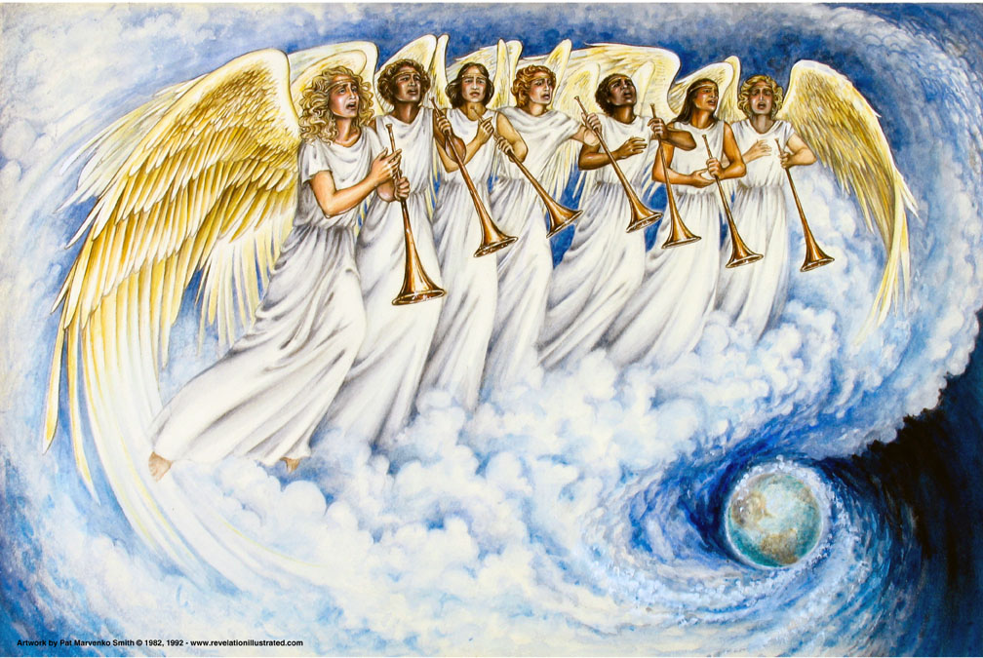
As the inside of the scroll was revealed, John saw seven trumpets given to seven angels. Let us examine now the detail.

Slide 69
As the inside of the scroll was revealed, John saw seven trumpets given to seven angels. Let us examine now the detail.

Slide 70
THE FIRST FOUR TRUMPET JUDGMENTS (Rev. 8:7-12)
These four judgments bring destruction and havoc upon a third of the earth. The phrase “a third of” appears 13 times in these verses. What does this mean?

Slide 71
THE FIRST FOUR TRUMPET JUDGMENTS (Rev. 8:7-12)
These four judgments bring destruction and havoc upon a third of the earth. The phrase “a third of” appears 13 times in these verses. What does this mean?

Slide 72
THE FIRST FOUR TRUMPET JUDGMENTS (Rev. 8:7-12)
These four judgments bring destruction and havoc upon a third of the earth. The phrase “a third of” appears 13 times in these verses. What does this mean?

Slide 73
It is possible that these judgments are coming primarily upon the area occupied by the kingdom of Antichrist which covers one third of the earth.
However it is equally possible that these judgments are scattered across the whole earth. This is the more likely interpretation since all of the green grass is burned and the effects upon the sun and moon would certainly be felt by the whole earth.

Slide 74
It is possible that these judgments are coming primarily upon the area occupied by the kingdom of Antichrist which covers one third of the earth.
However it is equally possible that these judgments are scattered across the whole earth. This is the more likely interpretation since all of the green grass is burned and the effects upon the sun and moon would certainly be felt by the whole earth.

Slide 75
It is possible that these judgments are coming primarily upon the area occupied by the kingdom of Antichrist which covers one third of the earth.
However it is equally possible that these judgments are scattered across the whole earth. This is the more likely interpretation since all of the green grass is burned and the effects upon the sun and moon would certainly be felt by the whole earth.

Slide 76
It is possible that these judgments are coming primarily upon the area occupied by the kingdom of Antichrist which covers one third of the earth.
However it is equally possible that these judgments are scattered across the whole earth. This is the more likely interpretation since all of the green grass is burned and the effects upon the sun and moon would certainly be felt by the whole earth.

Slide 77
It is possible that these judgments are coming primarily upon the area occupied by the kingdom of Antichrist which covers one third of the earth.
However it is equally possible that these judgments are scattered across the whole earth. This is the more likely interpretation since all of the green grass is burned and the effects upon the sun and moon would certainly be felt by the whole earth.

Slide 78
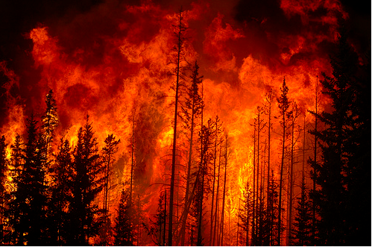
First Trumpet - 8:7 | Hail, fire, blood fall on the earth | 1/3 of the earth burned. 1/3 of trees destroyed. All grass destroyed.

Slide 79
First Trumpet - 8:7 | Hail, fire, blood fall on the earth | 1/3 of the earth burned. 1/3 of trees destroyed. All grass destroyed.

Slide 80
First Trumpet - 8:7 | Hail, fire, blood fall on the earth | 1/3 of the earth burned. 1/3 of trees destroyed. All grass destroyed.

Slide 81
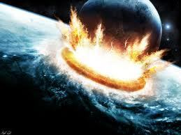
Second Trumpet - 8:8-9 | Fiery “mountain” falls into sea | 1/3 of sea becomes blood. 1/3 of sea life destroyed. 1/3 of ships destroyed.

Slide 82
Second Trumpet - 8:8-9 | Fiery “mountain” falls into sea | 1/3 of sea becomes blood. 1/3 of sea life destroyed. 1/3 of ships destroyed.

Slide 83
Second Trumpet - 8:8-9 | Fiery “mountain” falls into sea | 1/3 of sea becomes blood. 1/3 of sea life destroyed. 1/3 of ships destroyed.

Slide 84
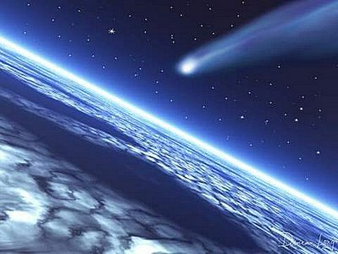
Third Trumpet - 8:10-11 | Blazing “star” falls into sea | 1/3 of rivers made bitter. Many die.

Slide 85
Third Trumpet - 8:10-11 | Blazing “star” falls into sea | 1/3 of rivers made bitter. Many die.

Slide 86
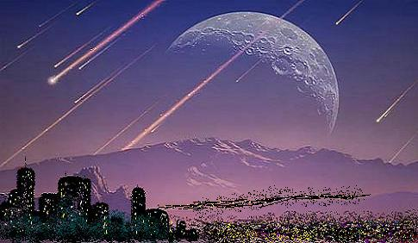
Fourth Trumpet - 8:12 | Sun, moon, stars struck | 1/3 of light taken away.

Slide 87
Fourth Trumpet - 8:12 | Sun, moon, stars struck | 1/3 of light taken away.

Slide 88
CONCLUSION: Chapter 8 ends with these words …
Revelation 8:13 And I looked, and I heard an angel flying through the midst of heaven, saying with a loud voice, “Woe, woe, woe to the inhabitants of the earth, because of the remaining blasts of the trumpet of the three angels who are about to sound!”

Slide 89
Each of the remaining Trumpet Judgments is so intense, that the angel calls them woes. Just a preview of what is to come: the fifth trumpet judgment brings demonic creatures to the surface of the earth; the seventh trumpet is The Great and Awesome Day of the Lord.

Slide 90
Each of the remaining Trumpet Judgments is so intense, that the angel calls them woes. Just a preview of what is to come: the fifth trumpet judgment brings demonic creatures to the surface of the earth; the seventh trumpet is The Great and Awesome Day of the Lord.

Slide 91
Each of the remaining Trumpet Judgments is so intense, that the angel calls them woes. Just a preview of what is to come: the fifth trumpet judgment brings demonic creatures to the surface of the earth; the seventh trumpet is The Great and Awesome Day of the Lord.

Slide 92
Each of the remaining Trumpet Judgments is so intense, that the angel calls them woes. Just a preview of what is to come: the fifth trumpet judgment brings demonic creatures to the surface of the earth; the seventh trumpet is The Great and Awesome Day of the Lord.

